Slide 1
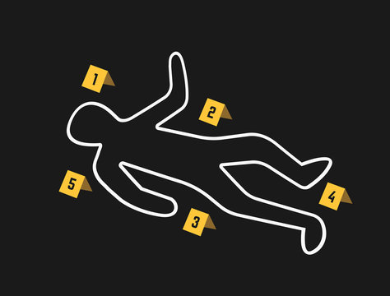
.
Bridgemere CE Primary School Class: 4 Term : Autumn Term
English
History - Crime and Punishment through the ages
Maths
Place value
Four Operations (+ - x /)
Problem solving
Reasoning
Real life context maths
Coding and Online Safety
Spreadsheets
Class story: Holes by Louis Sachar
Reading:
Hansel and Gretel – Neil Gaiman
Macbeth – William Shakespeare
Romeo and Juliet – William Shakespeare
The Highway Man – Alfred Noyes
Writing:
Dairy entry
Poetry
Persuasive letter
Narrative
Computing
Science
Art/D&T
Living Things and Their Habitats
Flowering plant reproduction
Ways that plants produce Asexually
Life Cycles – Insects and Amphibians, Mammalian and Bird Life cycles
Materials and their Properties
Sound proofing
Electrical Conductivity
Recycling
2D Drawing to 3D Making
Explore how 2D drawings can be transformed to 3D objects. Work towards a sculptural outcome or a graphic design outcome
Mechanical Systems
Pulleys and gears
Mechanical Systems
R.E/Spiritual and Moral
Life as a journey
Advent
Multi-Faith – Hinduism, Islam, Judaism, Sikhism
P.E
History
Geography
Football
Tag Rugby
Hockey
Handball
Understand what each case study believed about crime and punishment and recall some methods of punishment that were popular in these eras:
o Roman Britain
o Anglo-Saxon Britain
o Tudor Britain
o Victorian Britain
o World War Two (at home and on the frontline)
o Modern Britain (today).
.
Geography of Shrewsbury
Understand the importancxe of the River Servern to the local community. Using 4/6 figure grid references and tracing the river back to the source.
French
Recap on colours, numbers, simple phrases.
Project one:
Looking at shapes and using positional language.
Getting Loopy
Code Breakers
Music

