Slide 1
Year 6 SATs Presentation
Monday 11th –Thursday 14th May 2020

Slide 2
New curriculum 2014
The main aim is to raise standards, particularly as the UK is slipping down international student assessment league tables. Inspired by what is taught in the world’s most successful school systems, including Hong Kong, Singapore and Finland, as well as in the best UK schools, it’s designed to produce productive, creative and well educated pupils.
The primary curriculum is now significantly more demanding than in the past. For example, in mathematics there is now much greater focus on the skills of arithmetic and also on working with fractions.
For example, spellings for 8 and 9 year olds include "medicine" and "knowledge", by 10 and 11 they should be spelling “convenience" and "rhythm".

Slide 3
MATHS– Example Expectations Y6
Work with numbers to up ten million including negative numbers
Use standard method of long multiplication and long division
Solve complex problems using all four operations
Use common factors to simplify fractions, or to add fractions with different denominators
Multiply pairs of fractions together
Divide fractions by whole numbers.
Find percentages of quantities, such as 15% of £360
Use ratio to explain relationships and solve problems
Use simple algebraic formulae
Use a given formula to find the area of a triangle or parallelogram
Name and label the radius, diameter and circumference of a circle
Construct and understand pie charts and line graphs

Slide 4
KS2 Mathematics SATS tests
3 papers: 1 arithmetic paper – 2 mathematical reasoning papers.
Arithmetic test introduced to assess basic mathematical calculations.
No contextualised questions - 36 questions with 40 marks available, 30 minutes duration.
Questions will cover: straightforward addition and subtraction; more complex calculations with fractions; long division and long multiplication.
Gridded paper provided in answer spaces for questions on the arithmetic paper and some questions on Paper 2.

Slide 5
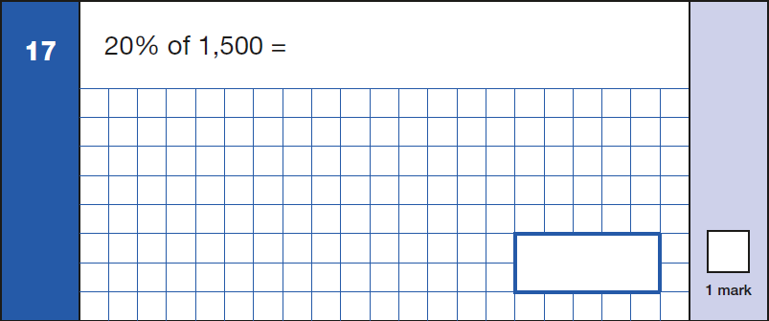
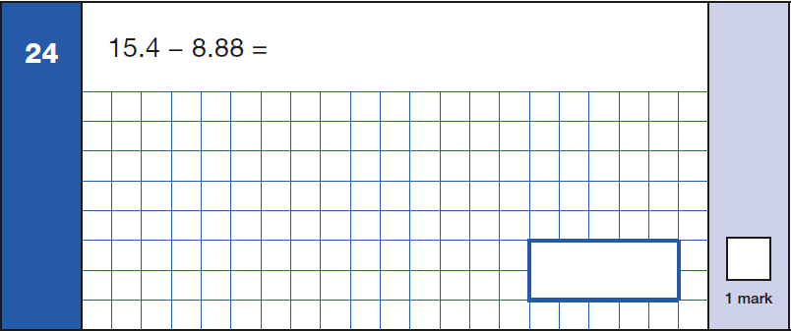
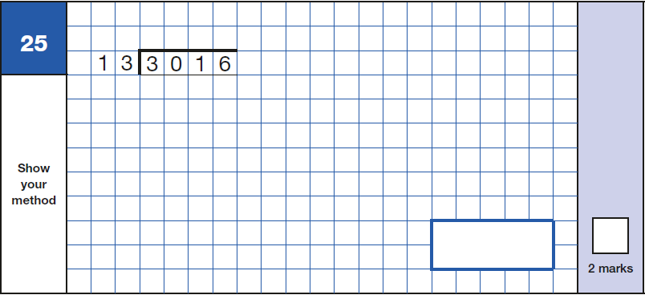
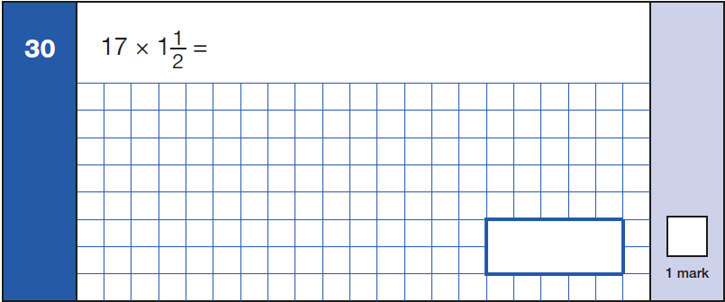
Year 6 – Arithmetic questions

Slide 6
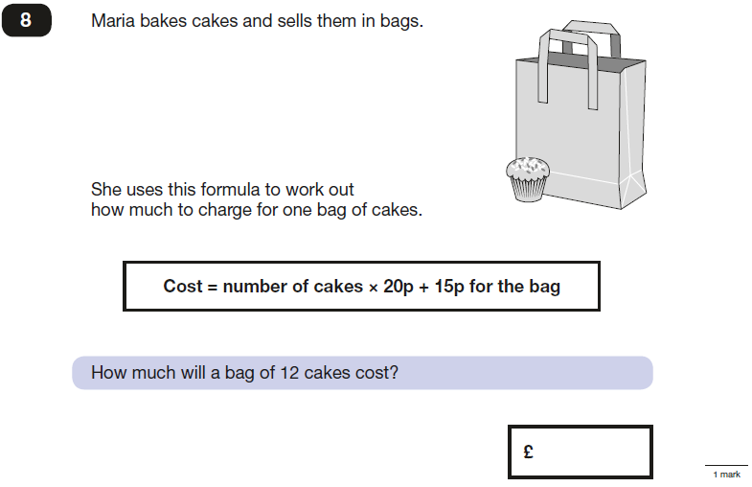
Year 6 – Reasoning papers

Slide 7
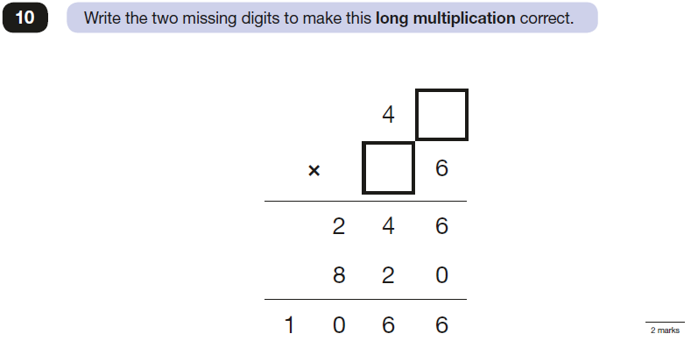
Year 6 – Reasoning papers

Slide 8
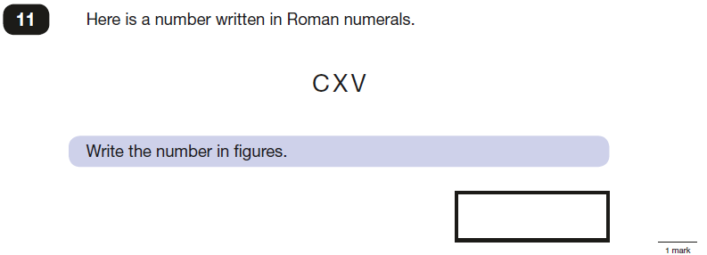
Year 6 – Reasoning papers

Slide 9
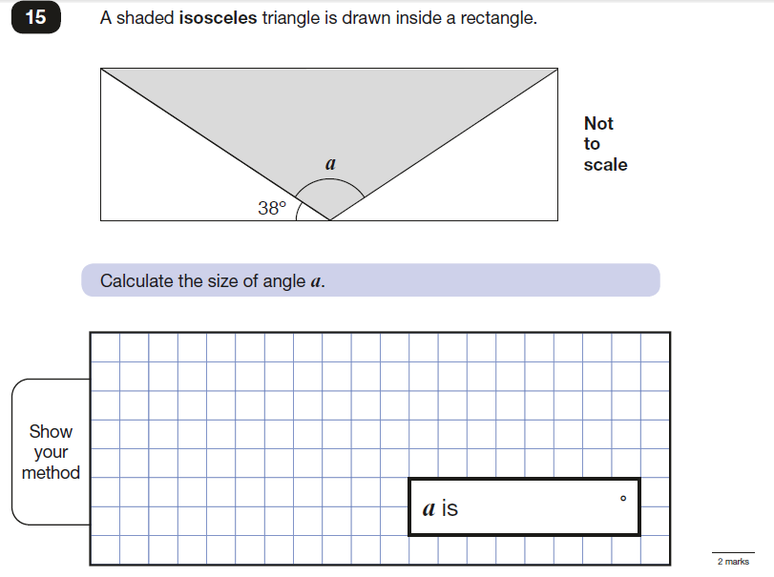
Year 6 – Reasoning papers

Slide 10
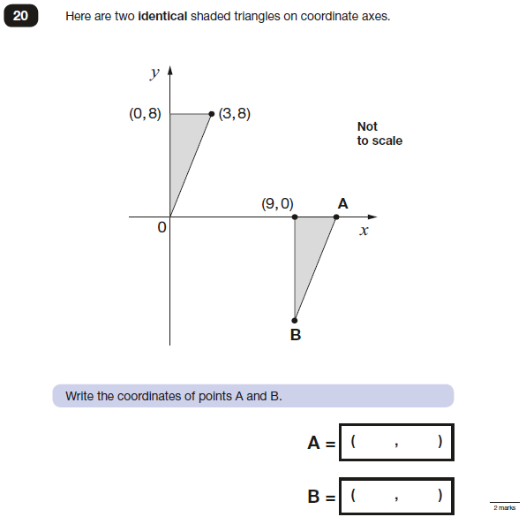
Year 6 – Reasoning papers

Slide 11
KS2 SPAG test
Two tests (combined score)
-English Grammar, Punctuation and Vocabulary (45 minutes) 50 marks
-Spelling Test (15 minutes) 20 marks
Questions from across the Key Stage 2 curriculum.
Greater focus on knowing and applying GRAMMATICAL TERMINOLOGY.

Slide 12
SPAG
The grammar and punctuation test will include two sub-types of questions:
Selected response, e.g. ‘Identify all the adjectives in the sentence below’
Constructed response, e.g. ‘Correct/complete/rewrite the sentence below,’ or, ‘The sentence below has an apostrophe missing. Explain why it needs an apostrophe.’
*Punctuation tested (marks dropped for punctuation errors within questions).

Slide 13
KS2 Tests - Reading
English reading - greater focus on fictional texts.
Retained a similar structure to the previous KS2 reading test.
Greater emphasis on reading in-between the lines (inference).
Each test will have 3-4 unrelated texts of increasing difficulty.
There will be a mixture of text types.
Vocabulary is challenging to read and understand – can they understand the meaning of the word from the context?

Slide 14
Writing
Not assessed by a formal sit down examination.
Children build up writing evidence throughout Year 6 – Teacher assessment.
Examples of work across the curriculum including different genres of writing.
Fiction – e.g stories, play scripts, diaries, newspapers
Non-fiction – e.g information texts, explanation texts
Vocabulary, SPAG and handwriting are key elements.

Slide 15
Time Table for The Week
Date | Tests
Monday 11th May | English Grammar and Punctuation (45 minutes) Spelling Test (15 minutes)
Tuesday 12th May | English Reading Test (60 minutes)
Wednesday 13th May | Mathematics: Paper 1 arithmetic test (30 minutes) Mathematics: Paper 2 reasoning (40 minutes)
Thursday 17th May | Mathematics: Paper 3 reasoning (40 minutes)

Slide 16
Why SATS?
Year 6 children take the end of Key Stage 2 Standard Assessment Tests.
They are sat formally, in silence with a time limit, and are externally marked.
If children are away then they cannot take the test.
The tests are used to monitor the progress of pupils by the Dfe.
Parents get written notification of the SATs results and they are passed onto the secondary schools.

Slide 17
Results- Scaled Scores
Pupils receive a raw score, scaled score and confirmation of attainment of the national standard.
National standard will be ‘100’
The ‘raw score’ that equates to 100 might be different each year.
Raw scores translated to scaled scores using a conversion table.
KS2 conversion tables published on GOV.UK on return of results day.

Slide 18
Top Tips
Encourage them to take up any offers of booster sessions in school.
Ensure homework that is given to the children in booster sessions is attempted.
Use Times tables Rockstars if you have the internet at home.
Use the BBC’s revision site.
Talk to them about the tests.
Listen to them read at home and question them about wht they have just read.
CGP books…

Slide 19
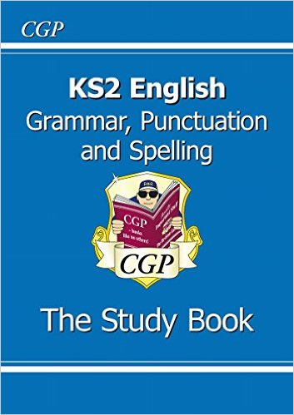
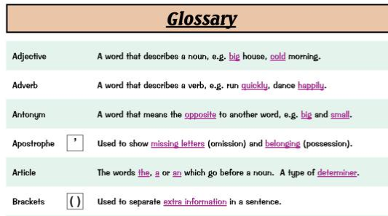

Slide 20
Example papers
Please look through some of these example papers and if you have any questions please feel free to ask.

