Slide 1
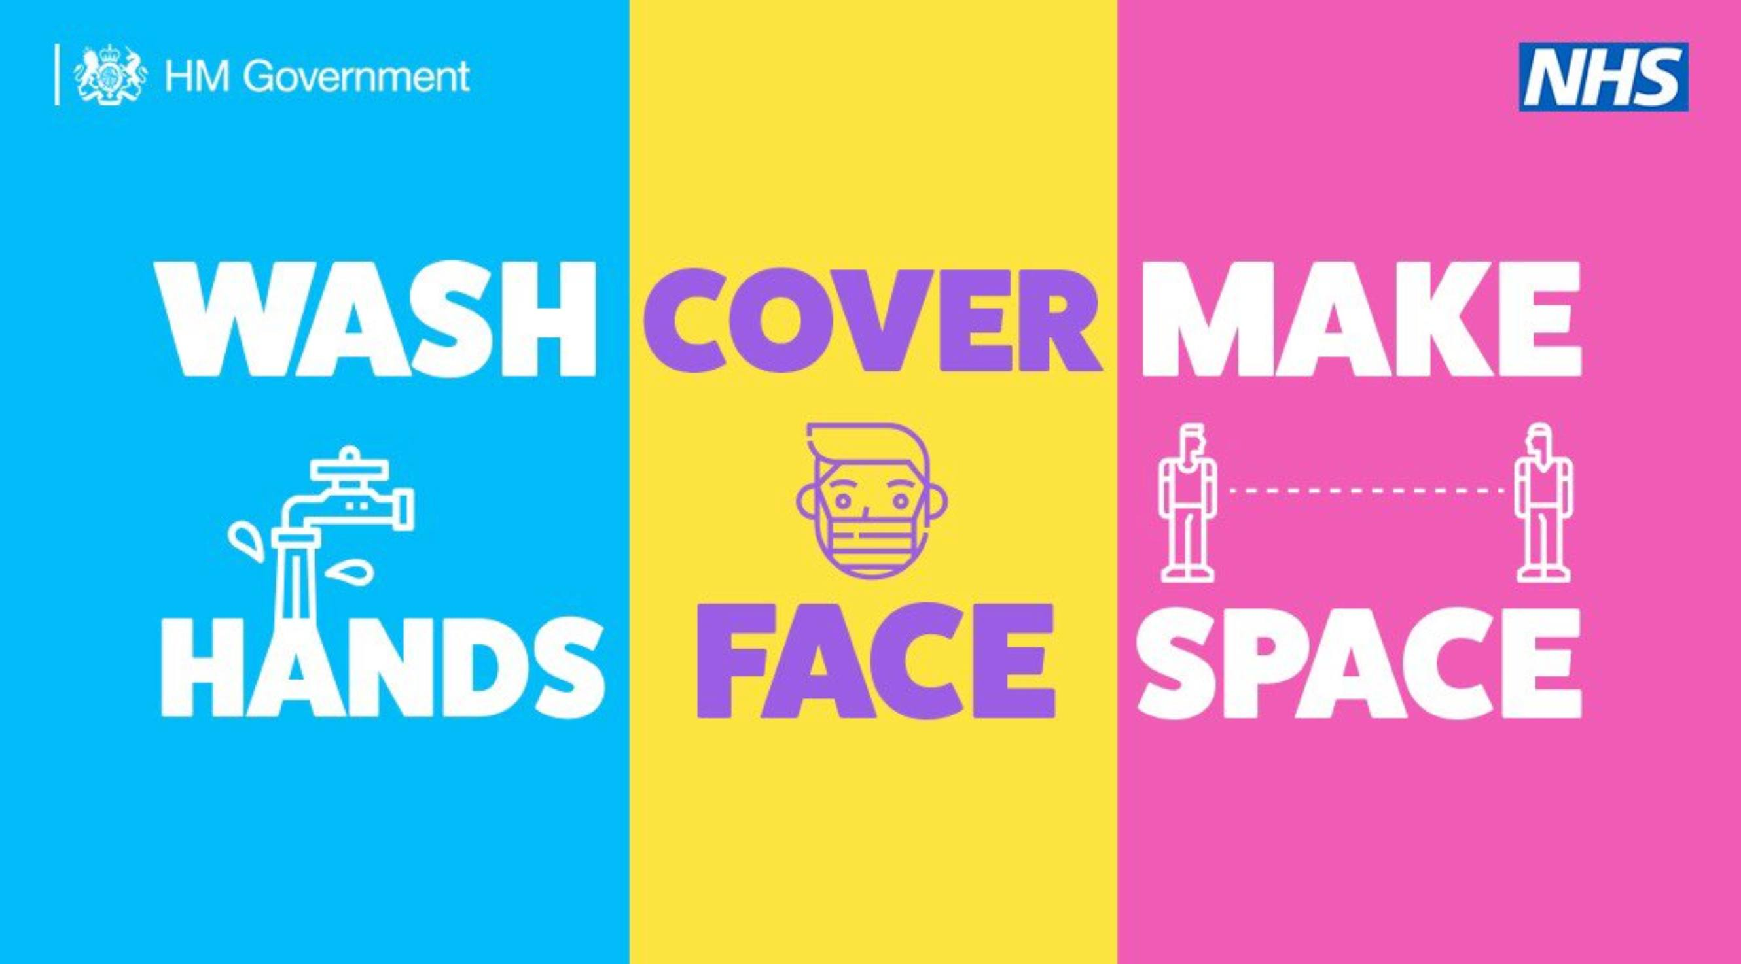

Slide 2
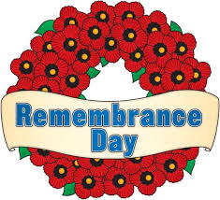
2020

Slide 3
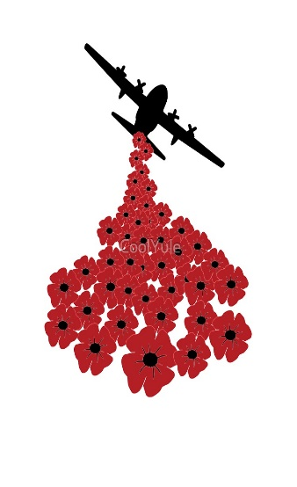
What is Remembrance Day
Armistice Day is on 11 November and is also known as Remembrance Day.
It marks the day World War One ended, at 11am on the 11th day of the 11th month, in 1918.
A two-minute silence is held at 11am to remember the people who have died in wars.
There is also Remembrance Sunday every year, which falls on the second Sunday in November.

Slide 4
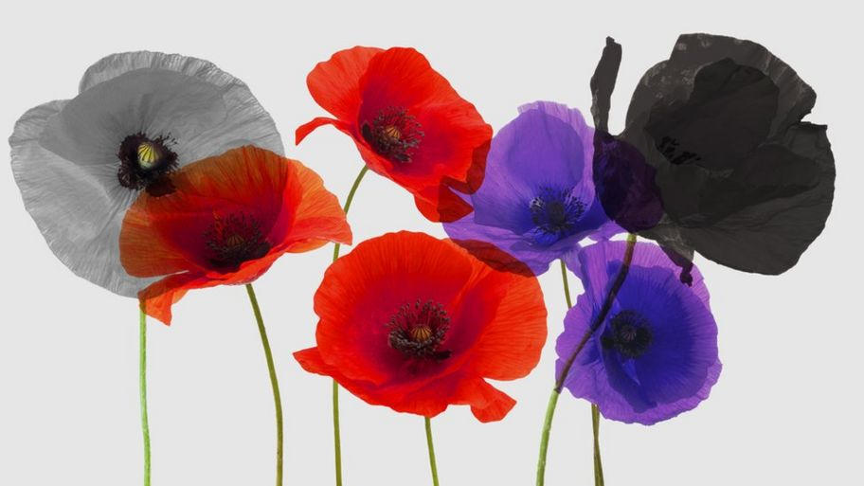
Red Poppies – Memorial to World War One and following conflicts.
Purple Poppies – To remember animal victims of war.
Black Poppies – Remembering African, Black and Caribbean
Poppies – Remember people who died in conflict with a focus on an end to war.
White

Slide 5
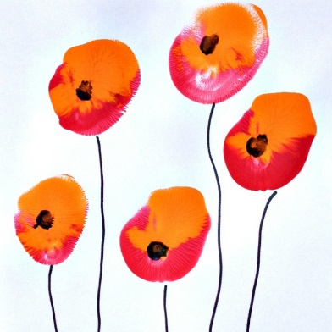
You might want to remember brave men and women who have fought in wars to keep us safe, by creating Poppy pictures or may be in some other way on Sunday 11th November 2020

Slide 6
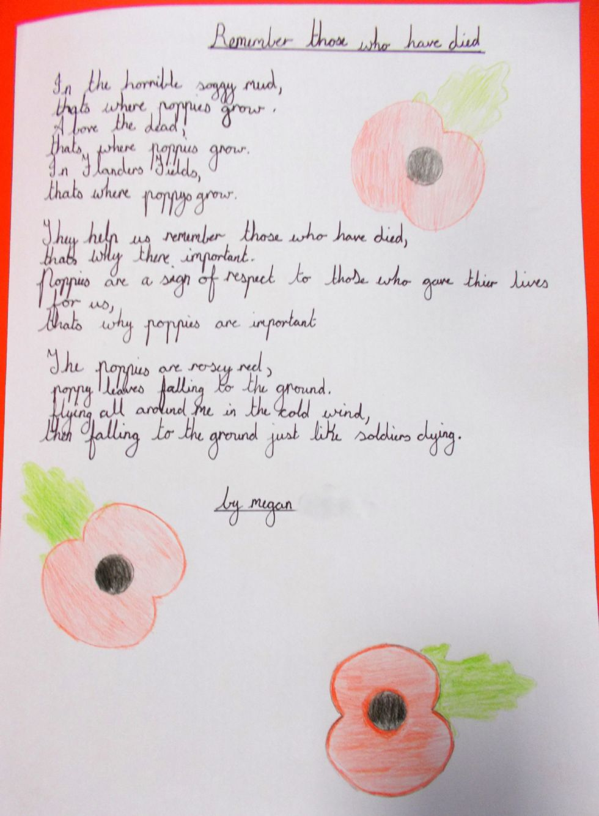
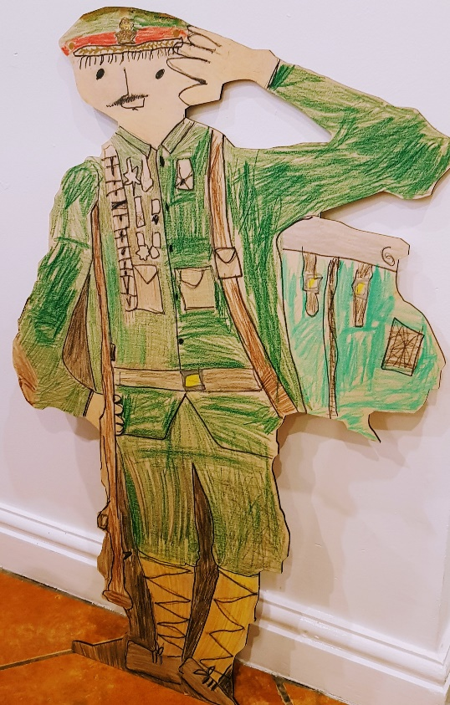
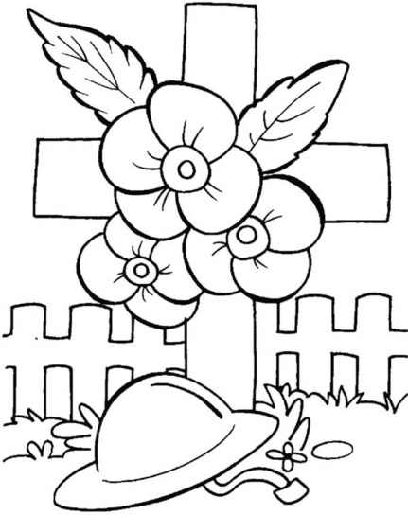
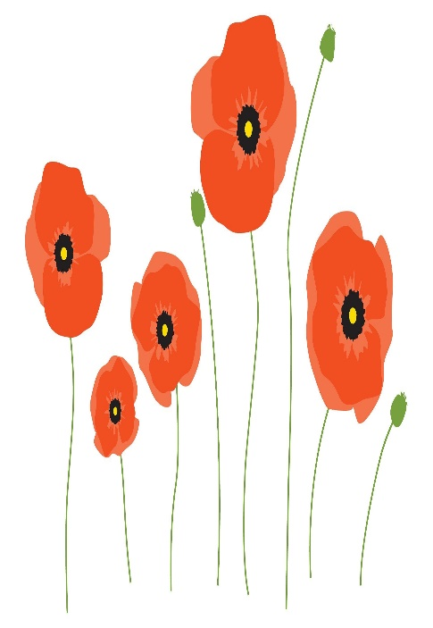
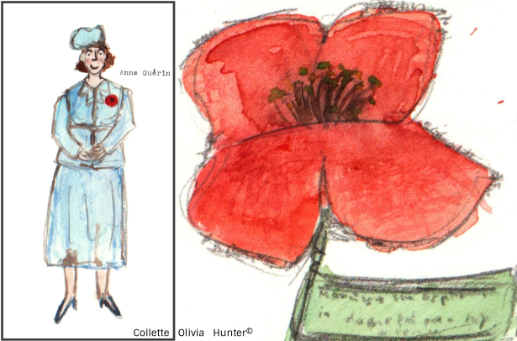
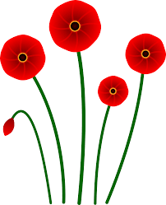
Some ideas for you
Maybe you could
Make up a poem.
Like Megan has done.
Remember those who have died
In the horrible soggy mud,
Thats where poppies grow.
I love the dead,
That’s where poppies grow
They help us remember those who have died,
Hats why there important.
Poppies are a sign of respect to those who gave their lives for us,
That’s why poppies are important
The poppies are rosey red,
Poppy leaves falling on the ground,
Flying all around me in the cold wind,
There falling to the ground just like soldiers dying
By Megan

