Slide 1

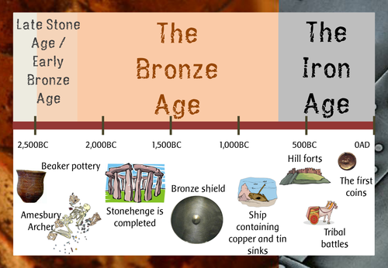
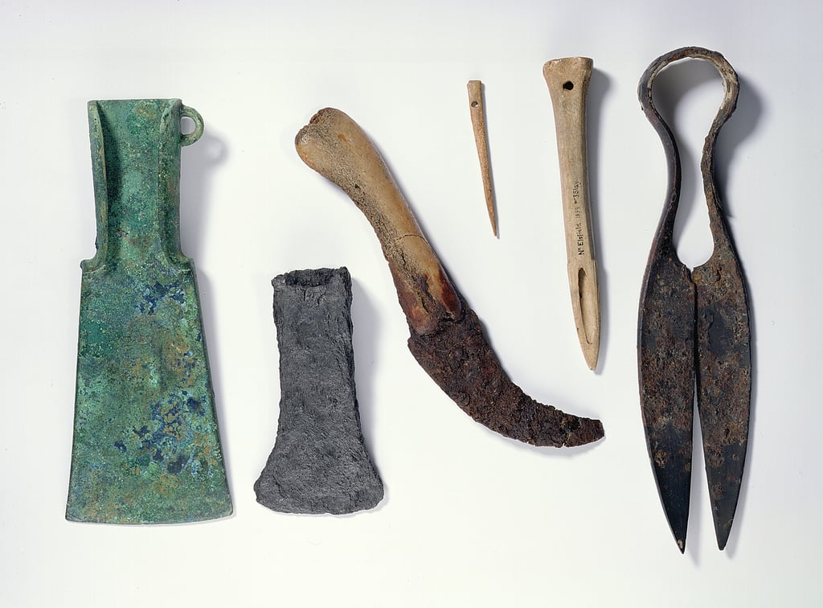
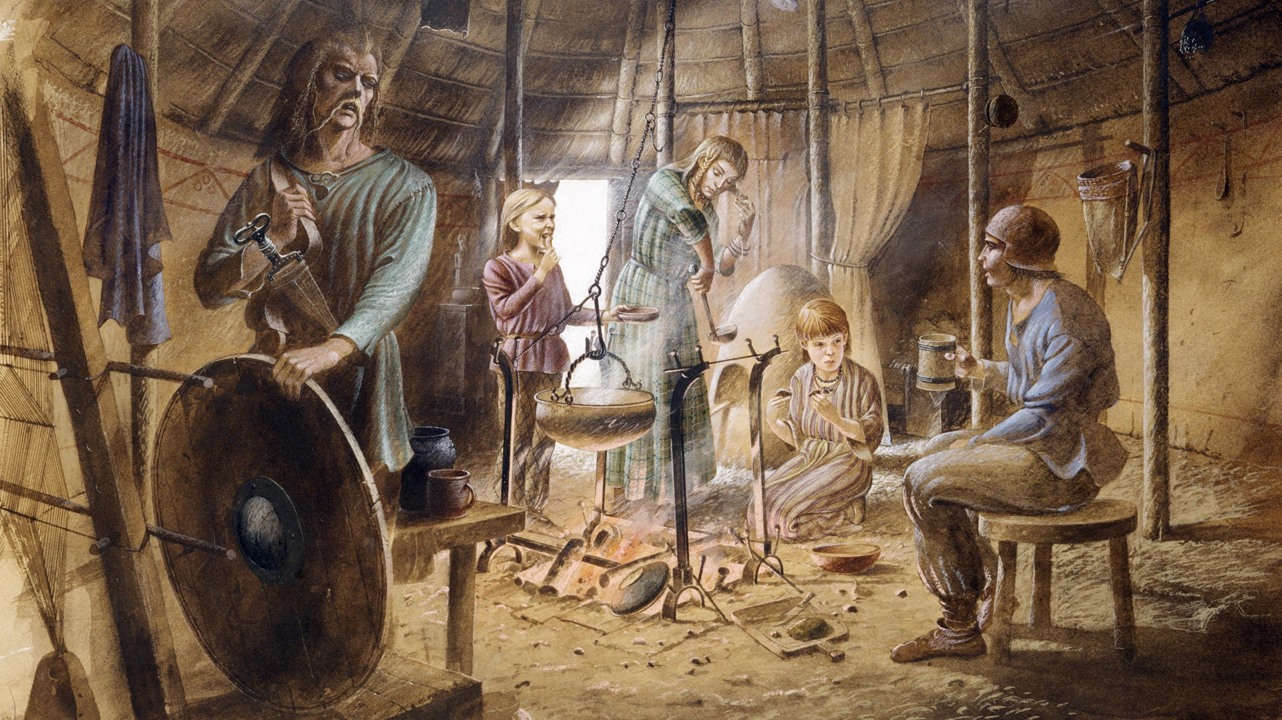
Bridgemere CE Primary Curriculum Spring term Class 3
.
English
Bronze Age to Iron Age
Maths
Texts:
Leaf - Sandra Dieckman
Manfish - Jennifer Berne
Writing:
Outsider narrative, information report, invention narrative, Biography.
Measure - length, mass, volume, time. Money, Graphs, fractions, decimals.
Art
Cloth, Thread, paint
Combining media
Science
PSHE
Living things and their habitats.
Plants and life cycles.
Differences and keeping safe.
Personal space
Belonging to a community
Media literacy and Digital resilience
Money and Work Different jobs and skills
My Happy Mind
Geography
Computing
How the landscape and land use of the United Kingdom has changed over time?
Touch typing
Email
Branching Database
.
P.E
Gymnastics
Swimming
Dance
History
D&T
Bronze Age - Iron Age
Changes over time
Comparison
Impact on our lives today
R.E/Spiritual and Moral
Textiles – making a coin holder
MFL
Music
Prayer - What is prayer? How do World Faiths Pray?
Easter - is the cross a symbol of sadness or joy?
Name -Je m’appelle,
Comment t’appelles-tu?,
Comment tu t’appelles?
Colours x 6
Numbers – 0- 6
Planet exploration
Painting a picture

