Slide 1

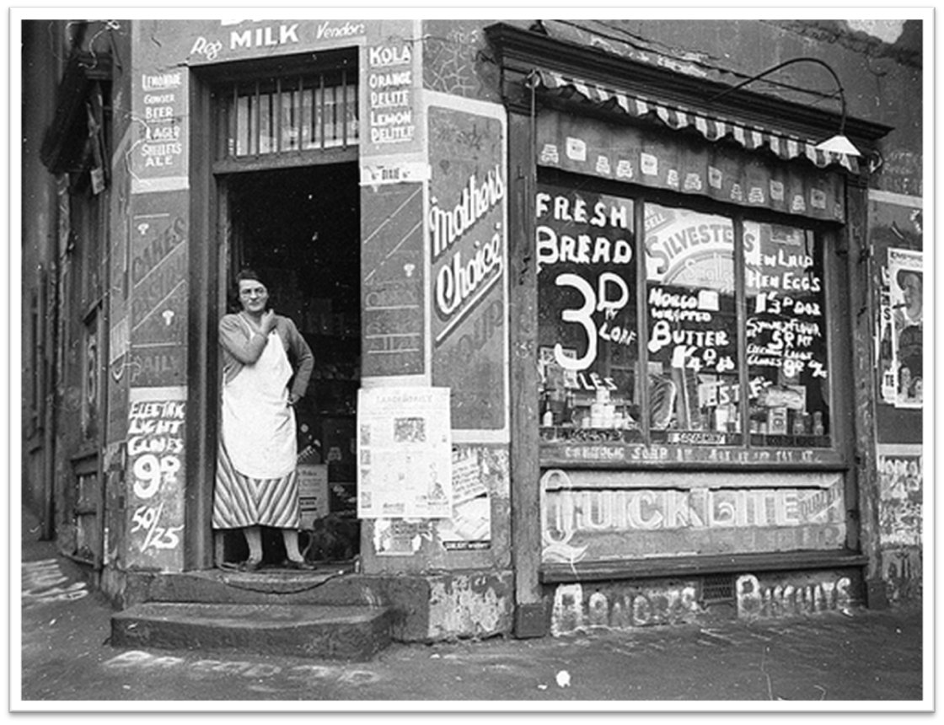
Bridgemere CE Primary School Year Group: Y1/2 Term: Spring
English
Changes within living memory!
This term, the children will be investigating our local area- Nantwich and changes in shopping over the last 100 years. We will be looking at what is close and far from our local environment and learning to understand the chronological change in shopping over time.
Maths
Year 1 will be learning about:
Geometry, Length and Height, Numbers to 40, Addition and Subtraction and Multiplication.
Year 2 will be learning about: Mass, Temperature, Picture Graphs, More Word Problems, Money, 2D and 3D shapes and Fractions.
In English, we will be using the texts ‘Rosie Revere Engineer ’ and ‘Grandad’s Island’ to help us to plan, write, edit and explain our own finding narrative and a non chronological report. We will also be looking at how we organise information communicate effectively.
Music
Art
In Music we will be developing listening skills and composing a piece of music using a story as a stimulus. We will listen to environmental sounds and writing symbols to represent rhythm patterns.
In Art, we will be a sculptural project making drawings from observation, exploring media, and transforming the drawings from 2d to 3d to make a bird.
Geography & History
Design and Technology
In Geography we will be exploring the geography of our local area- Nantwich. Showing routes on local maps using compass points to gain information.
In History, we will be investigating the changes in shopping over the last 100 years, and how this has affected our lives.
In design and technology, we will be focusing on textiles and working with templates and joining techniques.
R.E/Spiritual and Moral
P.E
Computing
In R.E we will be focusing on 2 key questions over the Spring term:
Jesus: What made Jesus special?
Easter: What do you think is the most important part of the Easter story?
Science
In Science, we will be exploring everyday materials comparing there suitability for different objects. As well as plants growth and what they need to survive.
In PE, we will begin the spring term with dance responding to a range of stimuli and types of music. Continuing with gymnastics focusing on introducing turn, twist, rock, roll and to link these.
In Computing, we will be about technology outside of school and what technology is. Grouping and sorting shapes on the computer and creating pictures based on impressionist art.

