Slide 1

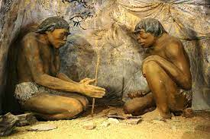
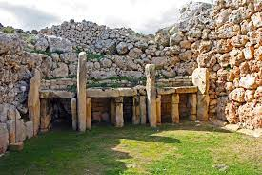
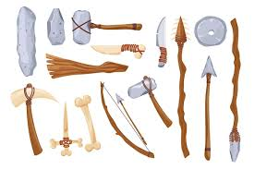
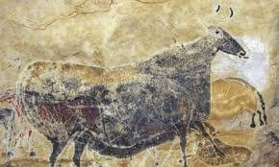
Bridgemere CE Primary Curriculum Autumn 1 and 2 Class 3
.
English
Stone Age -
Old to New Stone Age
Maths
Texts:
The Rhythm of the Rain - Grahame Baker-Smith
Leaf - Sandra Dieckmann
Writing:
Setting narrative, outsider narrative, information
Number and place value
Addition and subtraction
Multiplication and division
Art
Exploring Pattern
Science
PSHE
Forces and Magnets
Animals including humans - food, nutrition, skeleton
Valuing difference and keeping safe
Families and friendships
Safe relationships
Respecting ourselves and others
My Happy Mind
Geography
Computing
P.E
Locational knowledge of the UK
Online Safety
Coding
Spreadsheets
.
Tag Rugby
Football
Basketball
Indoor Athletics
History
Stone age
-
Old and New Stone age
Changes over time
Comparison
Impact on our lives today
R.E/Spiritual and Moral
D&T
MFL
Structures
Shell structures
Music
Kingdom of God
God/Incarnation
Greetings
Class commands
Colours
Christmas
Stone Age
Countdown to Christmas

