Slide 1

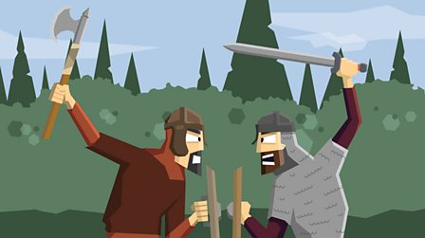


Bridgemere CE Primary School Curriculum Year Group: 5/6 Term : Autumn Term
.
The Vicious Vikings: The power struggle for Great Britain between the Anglo-Saxons and the Vikings
English
Maths
Text types:
Myth Narrative
Information text
Reading:
The Nowhere Emporium – Ross Mackenzie
Using dictionaries to check meaning
Using thesauruses to find synonyms
Singapore Maths
Fractions
Decimals
Percentages
Word Problems
Art/D&T
Typography & Maps
Exploring how we can create typography through drawing and design, and use our skills to create personal and highly visual maps
Science
Properties of Materials
Comparing and contrasting materials thinking about whether they are synthetic or natural.
Experimenting to see whether a material has flexibility, transparency and magnetism etc.
Computing
R.E/Spiritual and Moral
P.E
Spreadsheets
Looking at how we can input data and use software such as excel
Christian Community and Belonging to the Church
We will be looking at how local, national and global church communities are different and how the teaching of the church influences the life of a believer to make an impact in today’s world.
In PE we will be looking at:
Fitness – Long distance
Indoor Athletics
Football
Tag Rugby
History/Geography
This half term our learning in context is History, we will be looking at the power struggle for Great Britain between the Anglo-Saxons and the Vikings.
We will be looking at how Britain changed after the Romans left and how Britain has remained the same since the Vikings.
Music
Playing with instruments to create sound effects to represent different types of Viking music.
Basic oral skills including greetings, numbers to 50, days of the week, months and everyday classroom essentials

