Slide 1

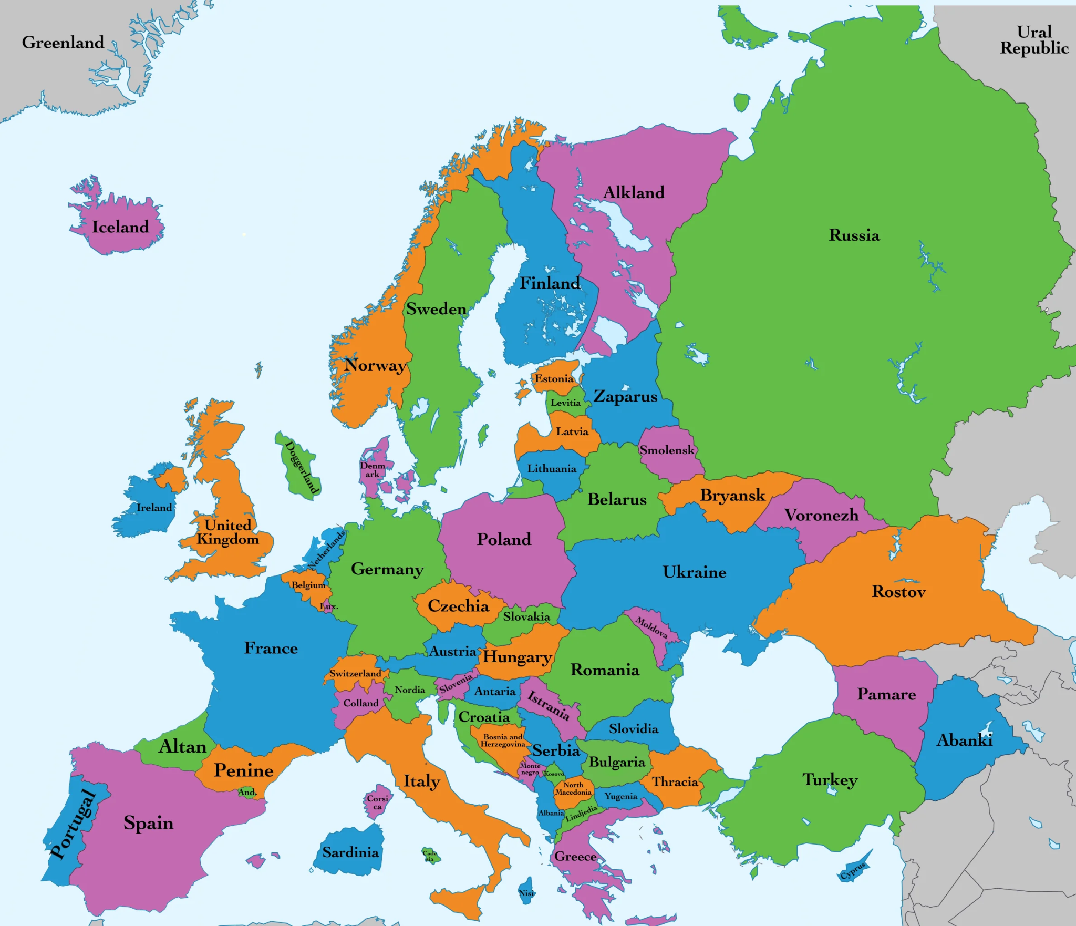
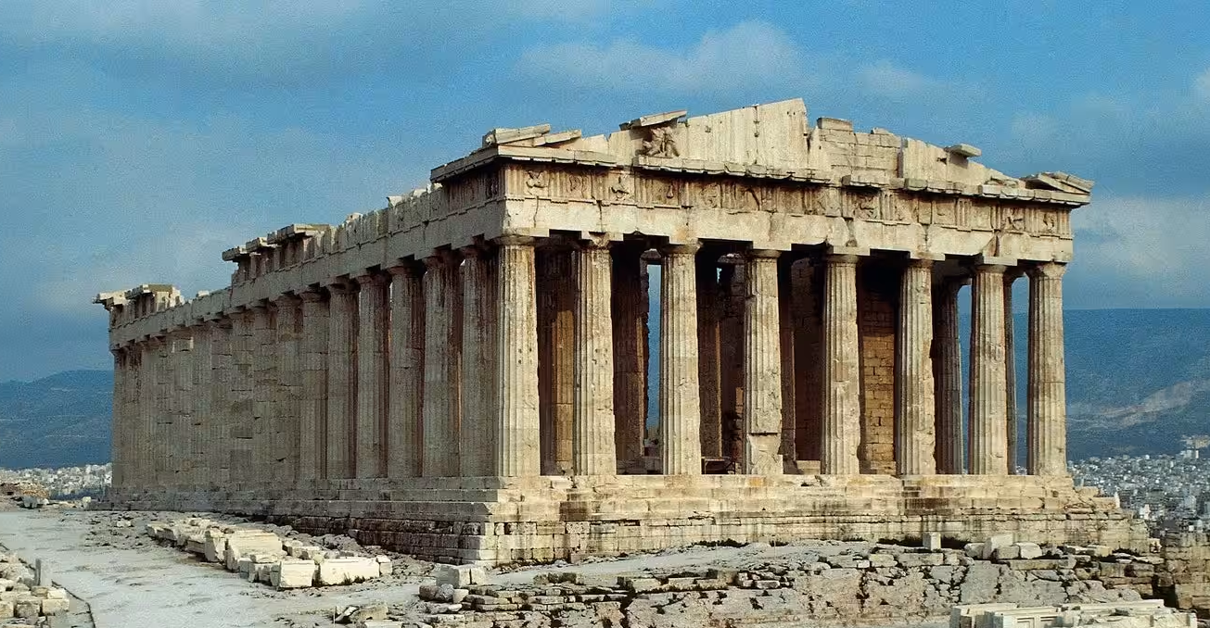
Bridgemere CE Primary Curriculum Summer term Class 3
.
Europe and
Ancient Greece
Maths
English
Graphs, Decimals, fractions, percentages, Angles, lines and shapes, perimeter.
Money, area, geometry, roman numerals.
Texts:
Iron Man - Ted Hughes
The Journey - Francesca Senna
Writing:
Threat Narrative, Explanation
Refugee Narrative, Diary recount
Art
Making Animated Drawings
Explore how to create simple moving drawings by making paper “puppets” and animate them using tablets
Science
Animals including humans - digestion and food chains
Electricity
P.E
PSHE
Geography
Computing
Athletics, Tennis
Cricket, Rounders
Growing Up -Healthy Relationships
Physical health and Mental wellbeing
Growing and changing
Keeping safe
My Happy Mind
Geography of Europe
Geography of Greece
Effective Search
Hardware Investigation
.
D&T
R.E/Spiritual and Moral
Electrical systems
Simple circuits & switches
History
The Church: Are all churches the same?
Are all places of worship the same? Do people worship God in the same way?
Jesus: How did/does Jesus change lives?
Achievements of the Ancient Greeks.
MFL
Music
Where in the world?
Holidays and Hobbies
Wider Opportunities - Play with the Halle
Meet and Greet
Say hello, wave goodbye

