Slide 1

Parent/carers information meeting
Year 6 SATs 2024 – 25

Slide 2
Aims of todays session
To share information about the KS2 SATs
To understand why children complete SATs
To support you with supporting your children at home

Slide 3
What are the SATs?
SATs are the Standardised Assessment Tests that are given to children at the end of
Key Stage 2.
The SATs take place over four days, starting on Monday 12th May ending on Thursday 15th May.
The SATs papers consist of:
  Grammar, punctuation and spelling (paper 1: GPS) – Monday 12th May
  Grammar, punctuation and spelling (paper 2: Spelling) – Monday 12th May
  Reading – Tuesday 13th May
  Maths (paper 1: Arithmetic) – Wednesday 14th May
  Maths (paper 2: Reasoning) – Wednesday 14th May
  Maths (paper 3: Reasoning) – Thursday 15th May
Writing is assessed using evidence collected throughout Year 6.

Slide 4
How is SATs week organised?
A timetable is issued to school, telling us on which days/sessions tests must be
Administered
  Grammar, punctuation and spelling (paper 1: GPS) – Monday 12th May
  Grammar, punctuation and spelling (paper 2: Spelling) – Monday 12th May
  Reading – Tuesday 13th May
  Maths (paper 1: Arithmetic) – Wednesday 14th May
  Maths (paper 2: Reasoning) – Wednesday 14th May
  Maths (paper 3: Reasoning) – Thursday 15th May
We will serve a free breakfast for children from 8:00am in school
Tests cannot be opened before the tests begin unless an early access arrangement
has been agreed with the DFE
Tests are completed in classrooms with displays covered

Slide 5
How is SATs week organised?
Some children may be divided into groups to ensure they are properly supported and
feel secure
The tests take place during normal school hours, under exam conditions.
After the tests are completed, the papers are sent away to be marked externally.
The results are then sent to the school in July.
Each test lasts no longer than 60 minutes:
Spelling, punctuation and grammar (paper 1: Grammar/ Punctuation) – 45 minutes
Spelling, punctuation and grammar (paper 2: Spelling)
Reading – 60 minutes
Maths (paper 1: Arithmetic) – 30 minutes
Maths (paper 2: Reasoning) – 40 minutes
Maths (paper 3: Reasoning) – 40 minutes
5

Slide 6
Specific arrangements for SATs
Children with additional needs (who have similar support as part of day-to-day learning in
school) may be allotted specific arrangements, including:
Additional (extra) time;
Tests being opened early to be modified;
An adult to scribe (write) for them;
Using word processors independently;
An adult to read for them;
The use of prompts or rest breaks;
Arrangements for children who are ill or injured at the time of the tests.
Support for children who have English as an additional language
Pupils with an EHCP are automatically allowed up to 25% additional time (except for the spelling paper, which is not strictly timed). All access arrangements need to be applied for using a statutory format and are not always successful.

Slide 7
During SATs week
Please ensure your child is in school every day during SATs week and in the run up to SATs
Ensure they are in school on time – we will serve a free breakfast for children from 8:00am in school
Please ensure appointments, holidays etc are not booked during SATs week
If your child is poorly, please let us know as soon as possible – as we will need to apply for a timetable variation

Slide 8
The results
Tests are marked externally. Once marked, the tests will be given the following scores:
A raw score (total number of marks achieved for each paper);
A scaled score
A judgement on if the National Standard has been met.
After marking each test, the external marker will convert the raw score to a scaled score. Even though the tests are made to the same standard each year, the questions must be different. This means the difficulty of the tests may vary. Scaled scores ensures an accurate comparison of performance over time.
Scaled scores range from 80 to 120.
A scaled score of 100 or more shows the child is meeting the National Standard and a scaled score of 110 or more shows the child is working above the National Standard.

Slide 9
Grammar, Punctuation and Spelling: Monday 13th May
Grammar, punctuation and spelling consists of two papers.
Paper 1 focuses on all three elements (grammar, punctuation and spelling or GPS). The paper lasts for 45 minutes.
Paper 2 consists of a spelling test only. It should take approximately 15 minutes, although this is not a set amount of time

Slide 10
Grammar, Punctuation and Spelling: Paper 1 (GPS)
The children will have been working hard with their class teacher on developing and
securing their knowledge of the technical vocabulary needed in this test.
This test focuses on:
Grammatical terms/ word classes;
Functions of sentences;
Combining words, phrases and clauses;
Verb forms, tenses and consistency;
Punctuation;
Vocabulary;
Standard English and formality.
This test requires a range of answer types but does not require longer formal answers.

Slide 11
Grammar, Punctuation and Spelling: Paper 1 (GPS)
Example questions:
✓
e.g. Although, While
e.g. Switch off the lights!
Please turn off the lights

Slide 12

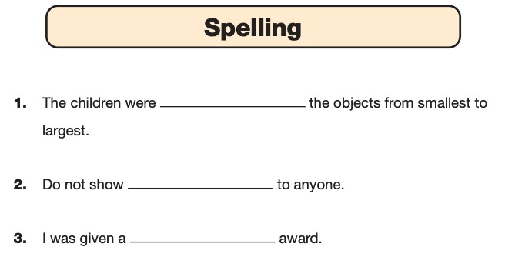

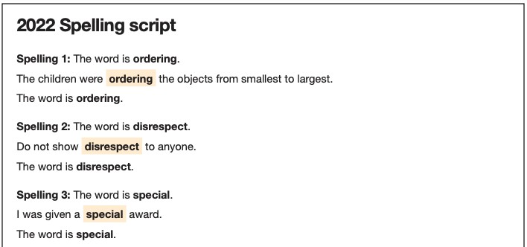
Grammar, Punctuation and Spelling: Paper 2 (spelling)
Paper 2 is a shorter paper that focuses solely on spellings.
Example questions:

Slide 13
How can you support spelling, grammar and punctuation at
home?
Reading a variety of texts – the more children read, the more familiar they become with different text types and sentence structures
Spelling homework – spelling lists / rules every week will be coming home after Christmas, these are not to be tested for the purpose of a spelling test
Encouraging your child to complete all homework and discussing their work with them

Slide 14
Reading: Tuesday 14th May
There is one reading test that lasts for 60 minutes.
The test is designed to measure if the children’s comprehension of age-appropriate reading material meets the national standard. There are three different set texts for children to read.
The test covers the following areas (known as Content Domains):
Give/ explain the meaning of words in context;
Retrieve and record information/ identify key details from fiction and non-fiction;
Summarise main ideas from more than one paragraph;
Make inferences from the text/ explain and justify inferences with evidence from the text;
Predict what might happen from details stated and implied;
Identify/ explain how information/ narrative content is related and contributes to meaning as a whole;
Identify/ explain how meaning is enhanced through choice of words and phrases;
Make comparisons within the text.

Slide 15


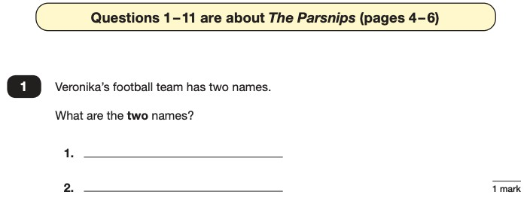
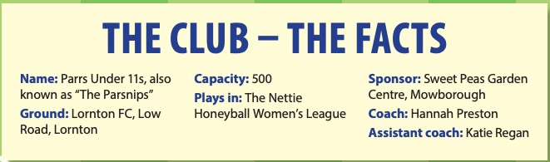

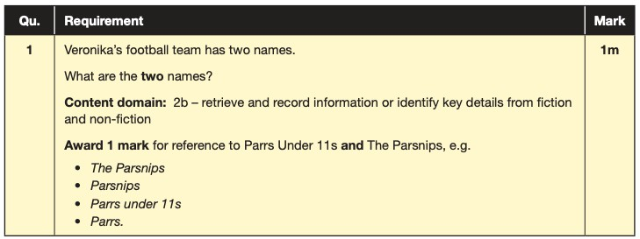
Reading
The reading SATs paper requires a range of answer styles.
Example questions:

Slide 16

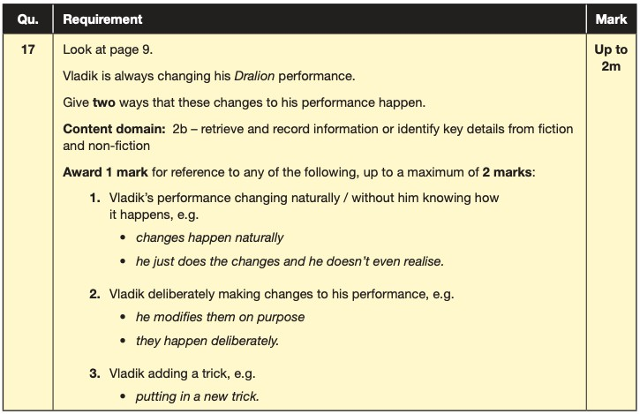

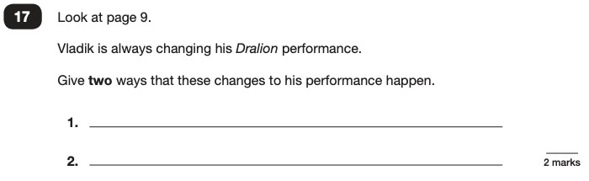

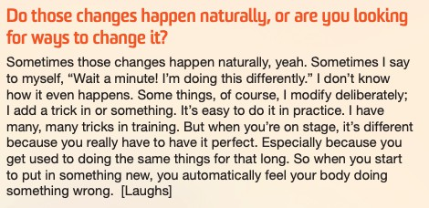
Reading
Example questions:
Based on text 2: My Circus Life

Slide 17

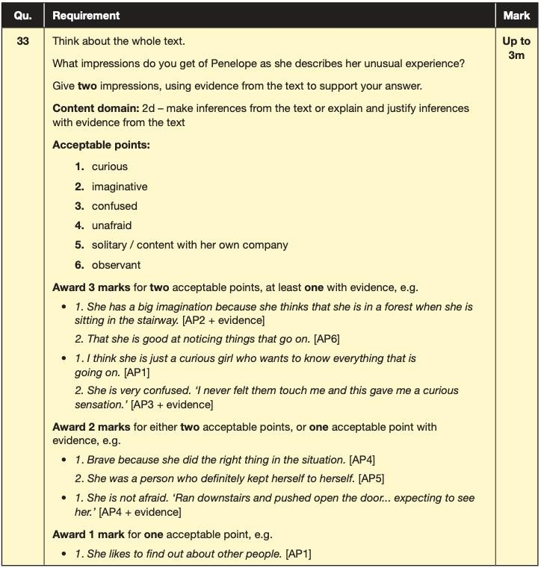

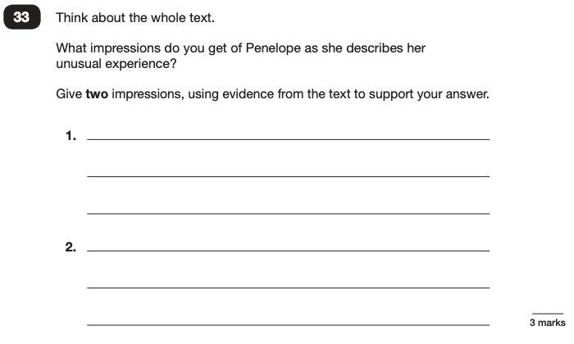
Reading
Example questions:
Based on the whole text

Slide 18
How can you support Reading at home?
Ensure your child reads every night!
Encourage them to read fiction and non-fiction.
Try to ask them questions about the text.
Help them with the different skills of reading especially ‘skim’ reading where they are looking for keywords in the text.
Speed reading
Discussing language. What does the word mean? Look up words together with an
app/dictionary

Slide 19
Maths: Wednesday 15th May and Thursday 16th May
The maths assessments consist of three tests.
Paper 1: Arithmetic (30 minutes) – Wednesday 14th May
Paper 2: Reasoning (40 minutes) – Wednesday 14th May
Paper 3: Reasoning (40 minutes) – Thursday 15th May

Slide 20


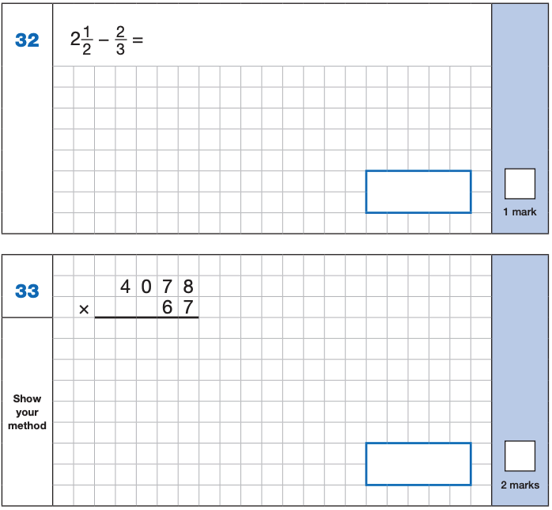
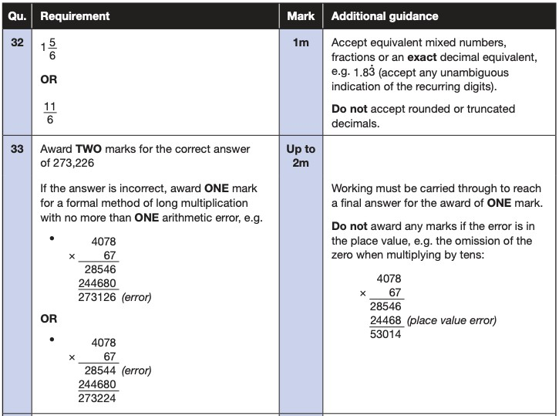
Maths Paper 1 (Arithmetic)
The maths arithmetic paper has a total of 40 marks and lasts for 30 minutes.
The test covers the four operations (addition, subtraction, multiplication, division, including order of operations requiring BIDMAS), percentages of amounts and calculating with decimals and fractions.
Example questions:

Slide 21
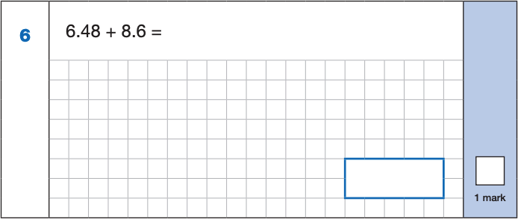
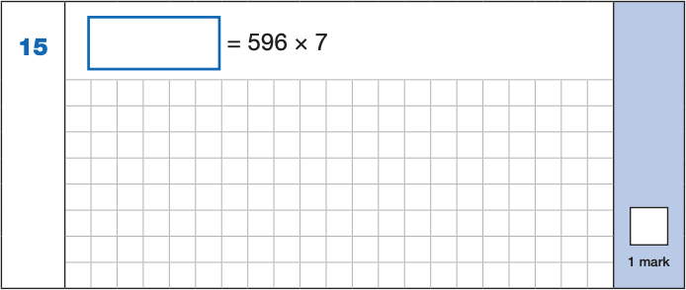
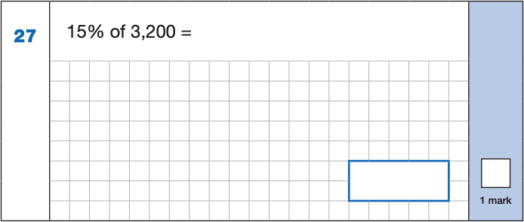
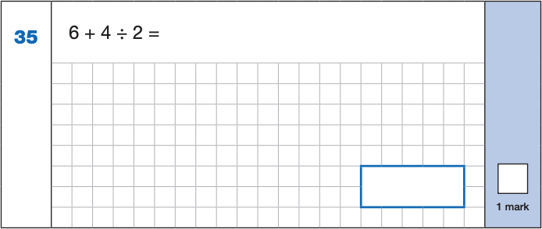
Maths Paper 1 (Arithmetic)
Example 1 mark questions:
4,172
6.48
+ 8.6
15.08
1
596
x 7
4172
6 4
15.08
10% of 3,200 = 320
5% of 3,200 = 160
15% of 3,200 = 480
4 ÷ 2 = 2
6 + 2 = 8
480
8

Slide 22
Maths Papers 2 and 3 (Reasoning)
Paper 2 will take place on Wednesday 15th May and paper 3 will takeplace on Thursday
16th May. These tests have a total of 35 marks each and lasts for 40 minutes each.
These papers require children to demonstrate their mathematical knowledge and skills, as well as their ability to solve problems and their mathematical reasoning.
Number and place value (including Roman numerals);
The four operations;
Geometry (properties of shape, position and direction);
Statistics;
Measurement (length, perimeter, mass, volume, time, money);
Algebra;
Ratio and proportion;
Fractions, decimals and percentages.

Slide 23


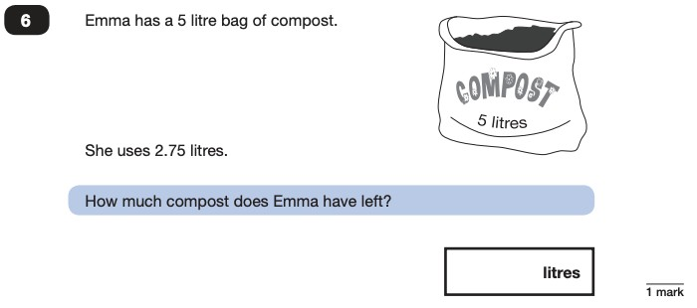
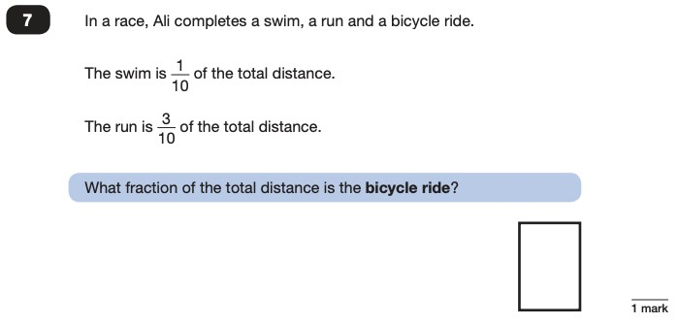
Maths Papers 2 (Reasoning)
Example questions:
6
10
2.25

Slide 24

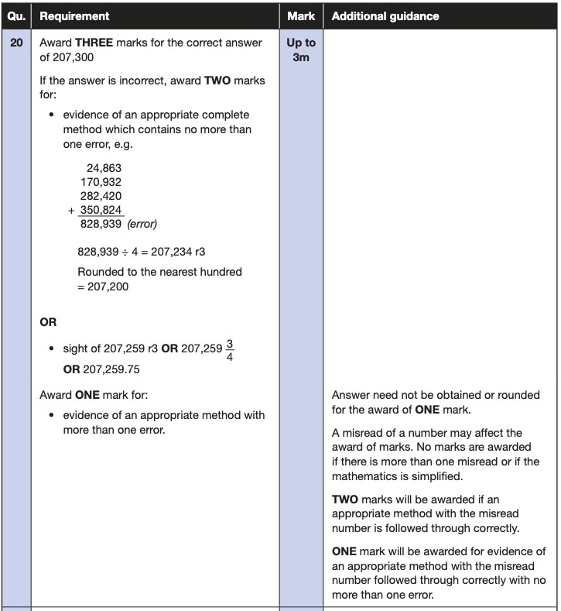

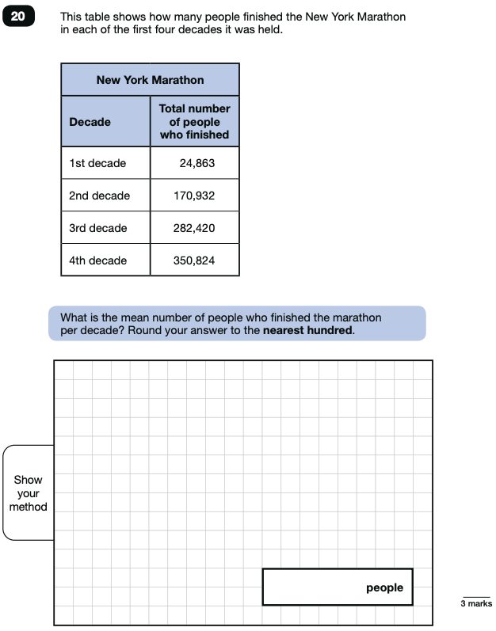
Maths Papers 3 (Reasoning)
Example question:

Slide 25
How can you support your child at home?
Support with going through SATs materials that will be sent home after Christmas – not just helping with the Maths but reading the question can really help.
Times tables - TTRockstars
Help your child to check their work through – this will help them to spot mistakes that can sometimes be easily fixed

Slide 26
Things to remember about SATs
SATs focus on what children know about Maths and English.
SATs don’t tell the whole story - Their results will say if they did or did not meet a certain standard but not necessarily by what margin. These thresholds change each year according to the overall national performance, so what was classed as ‘meeting the expected standard’ this year might not be the same as last year.
SATs are only four days out of a whole Primary School career.
They don’t take into consideration other strengths of your child.
Remember at the end of the day whatever happens with their SATs we are incredibly proud of them.

