Slide 1

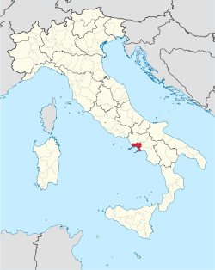
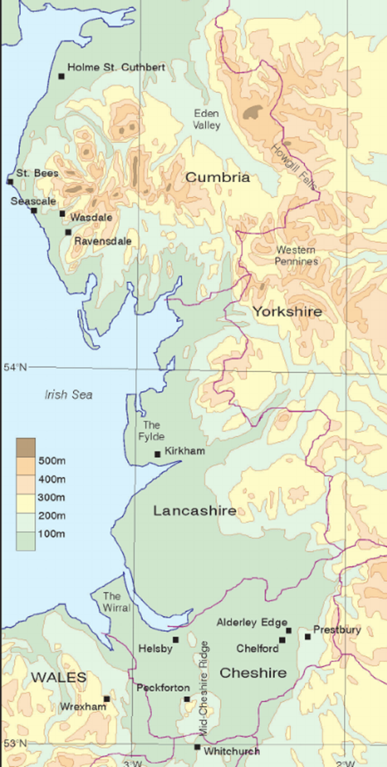
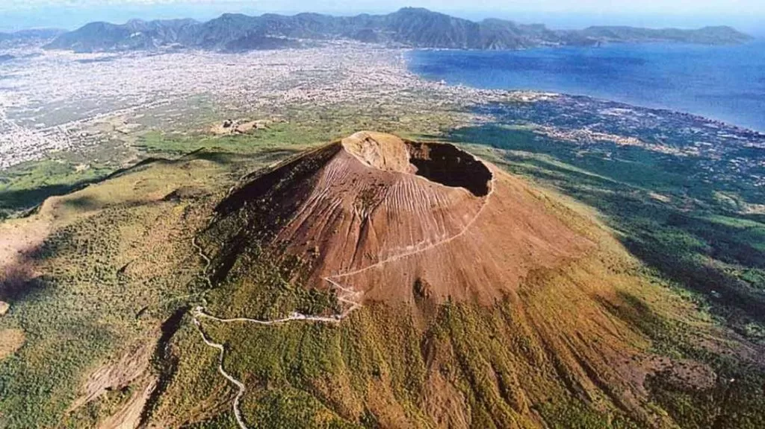
Bridgemere CE Primary Curriculum Autumn term 1 Class 3
How is the North west UK similar or different to the Naples Bay Region in Italy?
English
Maths
Texts:
The Whale - Vita Murrow
Fox - Margaret Wild
Writing:
Setting narrative, Newspaper report
Fable narrative, persuasion
Number and place value
Addition and subtraction
Multiplication and division
Art
Storytelling through drawing - accordion books/comic strips
Science
Rocks
Light
P.E
Football
Tag Rugby
KS2 Fitness
Hockey
PSHE
Growing Up -Changes
Families and friendships
Safe relationships
Respecting ourselves and others
My Happy Mind
Geography
North west England and the comparison of land and land use in Naple, Italy
R.E/Spiritual and Moral
Computing
David and the Psalms - What values do you consider to be important?
Christmas - What is Jesus described as the light of the world?
Why is light an important symbol is world faiths?
Online Safety
Coding
Spreadsheets
.
History
Looking at the history of Earthquakes and Volcanoes and their effect on the lives of those who live there.
D&T
MFL
Mechanical systems
Levers & linkages
Greetings
Class commands
Colours
Christmas
Music
Peter and the wolf
Christmas singing

