Slide 1

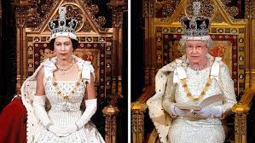
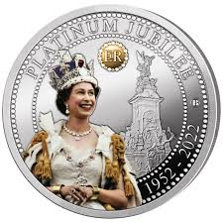

Bridgemere CE Primary School Curriculum – Queen Elizabeth II Platinum Jubilee
.
Queen Elizabeth II – 1952-2022
To celebrate the 70th year of Queen Elizabeth’s reign our curriculum from 16th May will incorporate unique learning opportunities and make it a special time to remember for everyone.
English
Maths
The children will be exploring a variety of texts linked to Queen Elizabeth II
The Queen’s Knickers
The Queen’s Hat
The Queen who Chose to Serve
The Young Princess who became Queen
Her Extraordinary life from Crown to Corgi
White Rose
Singapore Maths
These lessons will continue as normal in morning sessions across the school
Art/D&T
Art work linked to History and English links
Nantwich Education Partnership Timeline display for Pockets in Nantwich
Street Party Day
Friday 27th May
Non uniform day : Come in anything red, white and blue!
School lunch outside street party style
Queen Jubilee group activities across the day
Friends of Bridgemere:
Friends of Bridgemere are planning a Queen’s Jubilee Afternoon Tea on the afternoon of Thursday 26th May – all welcome
History/Geography
R.E/Spiritual and Moral
P.E
Each year group will be exploring a different decade from the 1950’s -2020’s.
They will create a decade display for a timeline to be displayed in the hall.
Royal Family Tree
Time Capsule : to put under the Jubilee Tree to be planted in school grounds
Christian value: Community
Linked to Platinum Jubilee
Queen Elizabeth's commitment to serve God and her country
PE sessions will continue as normal. There will also be opportunity for the children to experience a range of different childhood games from the 1950’s to the present day.
Music
National Anthem:
To understand the purpose of a National Anthem
To reflect on how past history shapes our future

