Slide 1



Slide 2

Scarecrow & Halloween
Posters 2020
This year we would like you to get spookily creative and design a poster that can be displayed in your windows for the Halloween and Bonfire season.

Slide 3


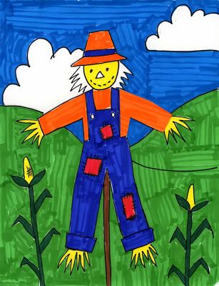

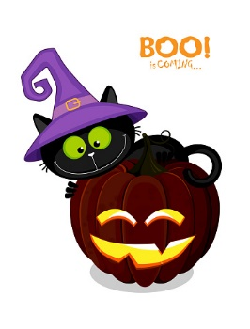


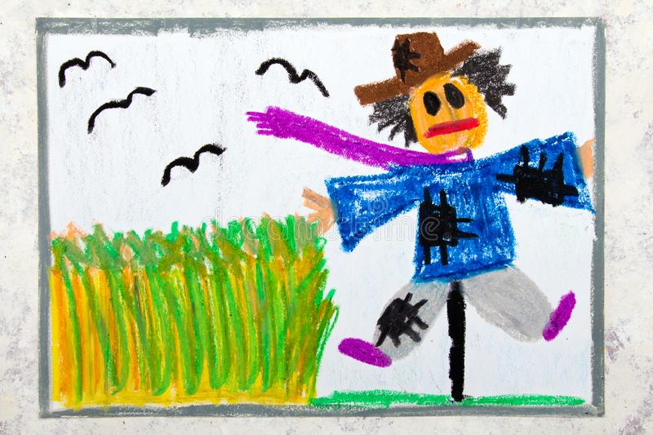
How Creative can you be?

