Slide 1
Accelerated Reader (AR)

Slide 2
What is Accelerated Reader?
It is a computer program that helps teachers monitor and manage children’s independent reading practice.
It enables your child to be able to pick a book of their own choice, at their own level and read it at their own pace.

Slide 3
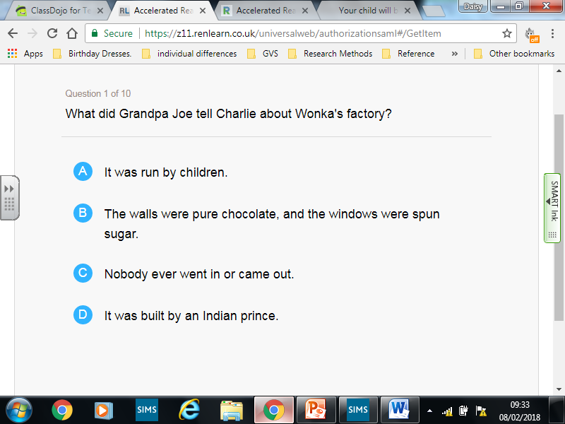
Sample Quiz Question

Slide 4
What is a book level?
Your child will by now have already sat a STAR reading assessment quiz or will be likely to sit one soon. This tests your child’s comprehension skills, understanding of vocabulary and grammar.
At the end of the assessment your child will be given a ZPD range (book level) – this is the level of books that they ideally should be reading.

Slide 5
Daily Reading
Children should be reading between 30 – 45 minutes everyday. (School sets aside at least 20 minutes a day so we encourage parents to match that time).
Once your child has completed reading a book they will go to the computer and complete a comprehension quiz about that book. Children have a target of maintaining a 85% comprehension rate as this sees the greatest gains.

Slide 6
Points
Every time your child reads a book and completes a test they will earn points.
The amount of points your child earns is dependant upon the difficulty/length of the book.
For example
Horrid Henry’s Birthday Party has a book level of 2.8 and is worth 0.5 points.
The Witches has a book level of 4.7 and is worth 5 points.

Slide 7
How can you help?
Daily reading with questioning at home with your child.
You can check to see if any of your child’s books at home are on their book level by going to www.arbookfinder.co.uk
Alternatively you can find new books according to your child’s interests by using the website and selecting advance book search.

Slide 8
What is IDL?
IDL is a multi sensory spelling and reading programme.
It was specifically designed as an intervention to help dyslexic children with reading and writing. However we have found (and lots of other schools around the country) that it is a really effective whole school approach to spelling that shows good results.

Slide 9
How do you use it?
It is an iPad or something similar app which can be used at both home and school.
Your child will have already done an initial assessment. This then allows your child to be given a programme tailored to their needs and requirements.

Slide 10
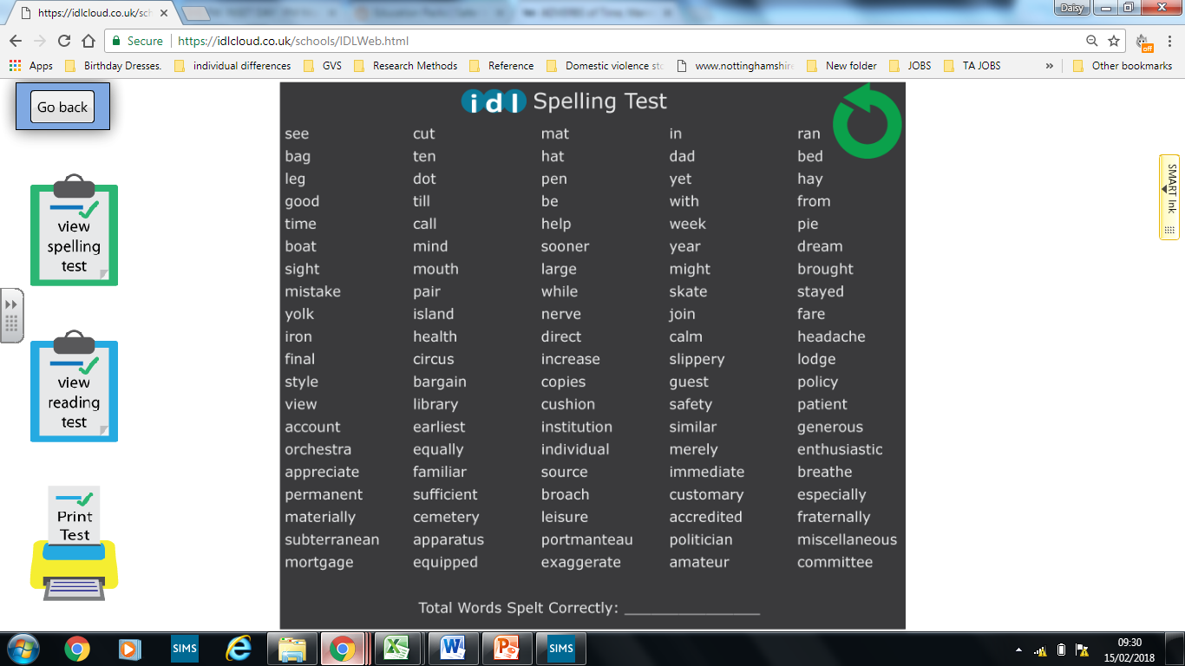

Slide 11
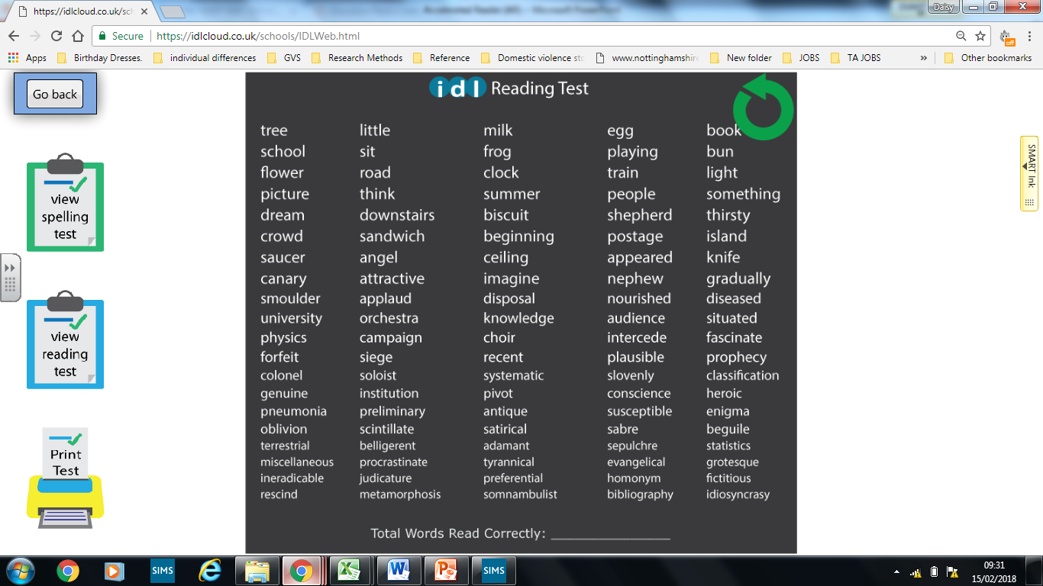

Slide 12
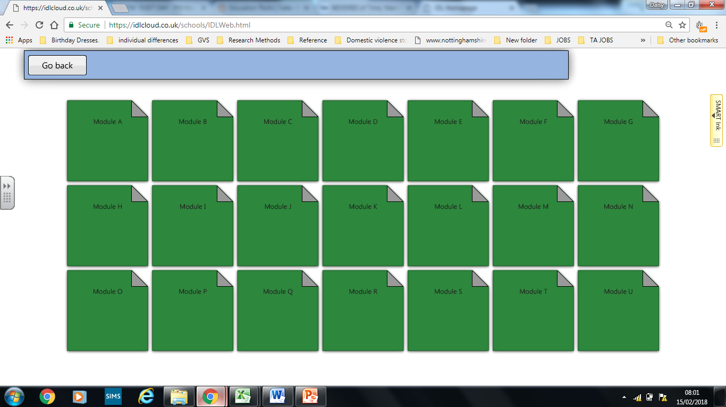

Slide 13
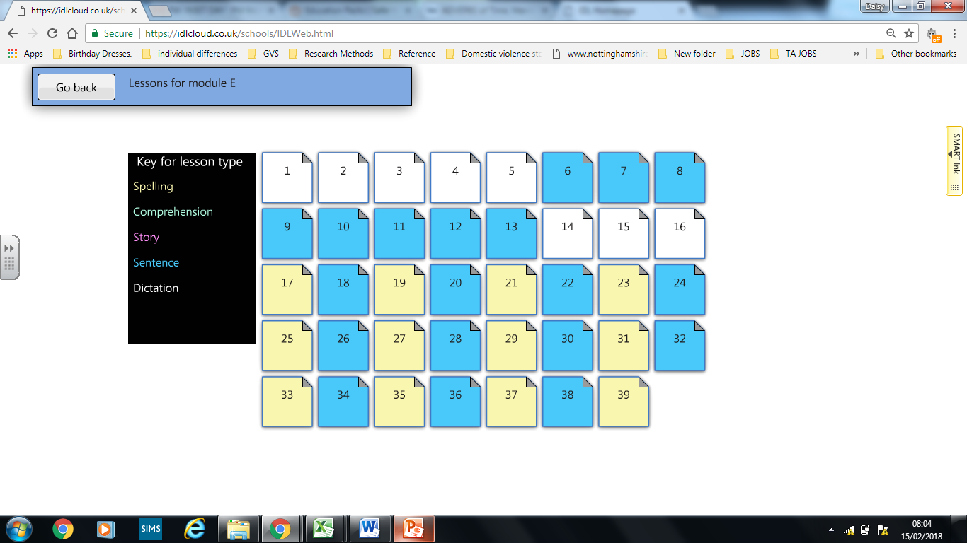

Slide 14
This programme is not just for those who seem to be struggling with spelling and reading.
It has also successful with aiding the progress of spelling more complex words and increasing pace and fluency when reading.

Slide 15
Any questions?

Slide 16
There are iPads set up around the room for you to have a go at IDL if you would like.
There are also a selection of computers set up with example AR reader tests for you to have a go at.

