Slide 1

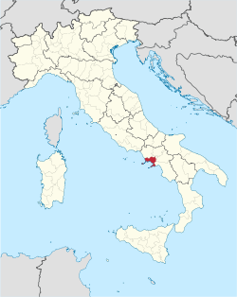
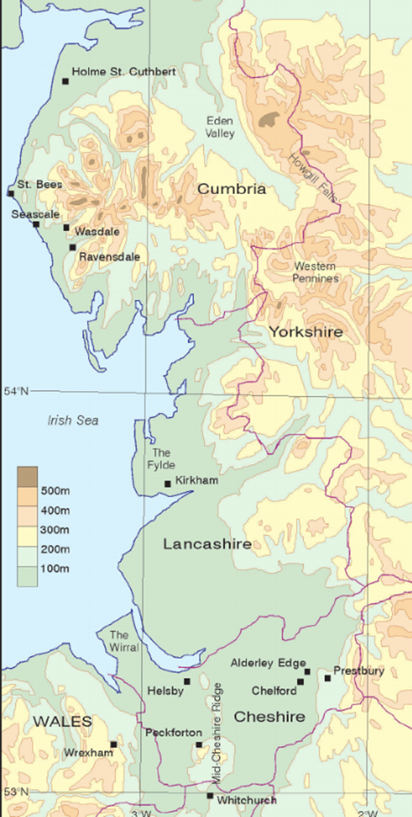
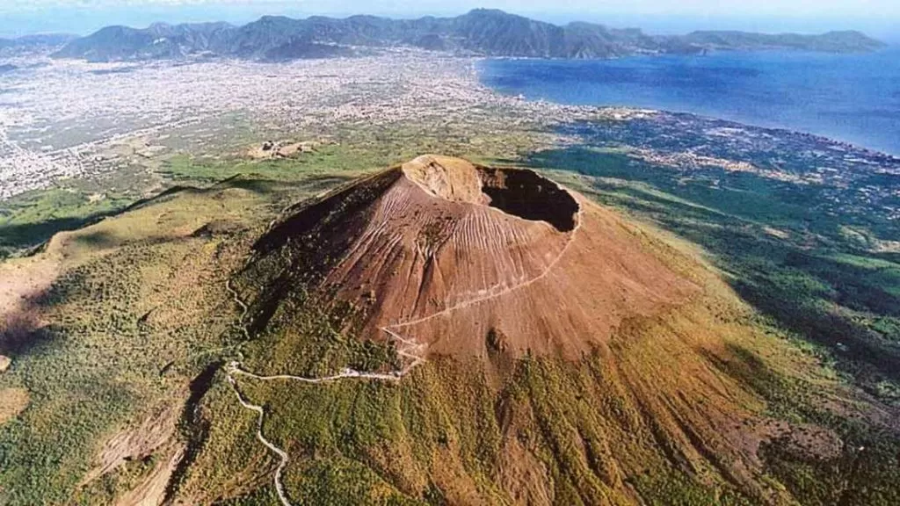
Bridgemere CE Primary Curriculum Autumn term Class 3
How is the North West UK similar or different to the Naples Bay Region in Italy?
English
Maths
Texts:
Iron Man - Ted Hughes
The Invisible - Tom Percival
Writing:
Approaching threat narrative, Trap explanation
Becoming invisible narrative
Number and place value
Addition and subtraction
Multiplication and division
Art
Storytelling through drawing - accordion books/comic strips
Science
Rocks
Light
P.E
PSHE
Tag Rugby
KS2 Fitness
Hockey
Growing Up -Changes
Families and friendships
Safe relationships
Respecting ourselves and others
My Happy Mind
Geography
North West England and the comparison of land and land use in Naples, Italy
R.E/Spiritual and Moral
D&T
Computing
David and the Psalms - What values do you consider to be important?
Christmas - What is Jesus described as the light of the world?
Mechanical systems
Levers & linkages
Online Safety
Coding
Spreadsheets
.
MFL
History
Greetings
Class commands
Colours
Christmas
Looking at the history of Earthquakes and Volcanoes and their effect on the lives of those who live there.
Music
Peter and the wolf
Christmas singing

