Slide 1

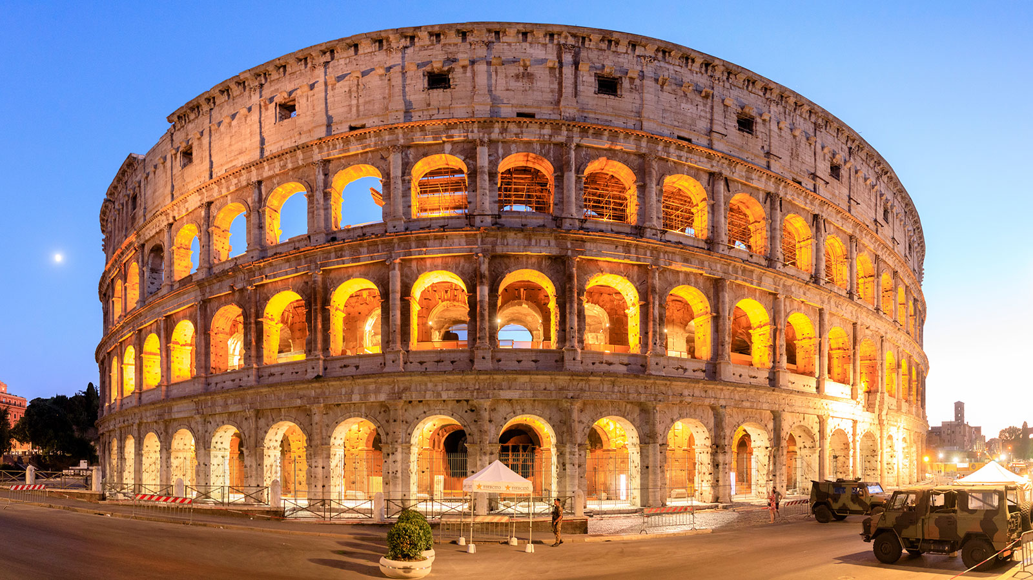

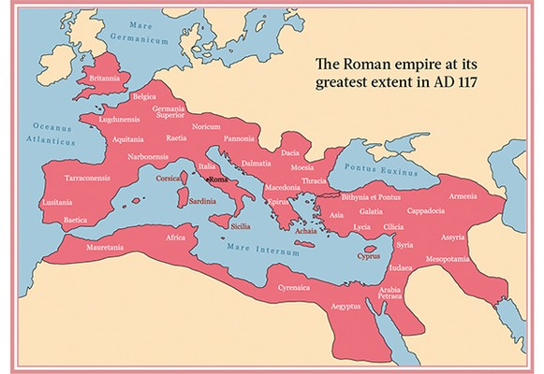
Bridgemere CE Primary Curriculum Summer term Class 3
.
English
The Roman Empire
Maths
Texts:
Pip and Egg – Alex Latimer
It fell from the sky – The Fans Brothers
Manfish – Jennifer Berne
Writing:
Transformation narrative, Complaint letter, Inverntion narrative, biography
Statistics,
geometry, measurement
Art
Festival Feasts
Bringing food and art together
Science
PSHE
States of Matter – Solids, Liquids gases – The water cycle
Sound
Valuing difference and keeping safe
Growing and Changing
My Happy Mind
Geography
Computing
Locational knowledge of the UK
Place Knowledge
Coasts, landscapes and seas
Simulations
Graphing
Presenting
.
P.E
Athletics
Rounders
Cricket
Tennis
History
D&T
The Roman Empire and its impact on Britain.
R.E/Spiritual and Moral
Food
Healthy varied diet
MFL
Music
Rules for living: which should we follow?
Proverbs: Is the book still relevant today?
Numbers
Animals
Qu’est-ce que c’est? C’est Ce n’est pas Voyelle/Consonne
Wider opportunities - Come and play at the Hallé
Tasty tunes

