Slide 1
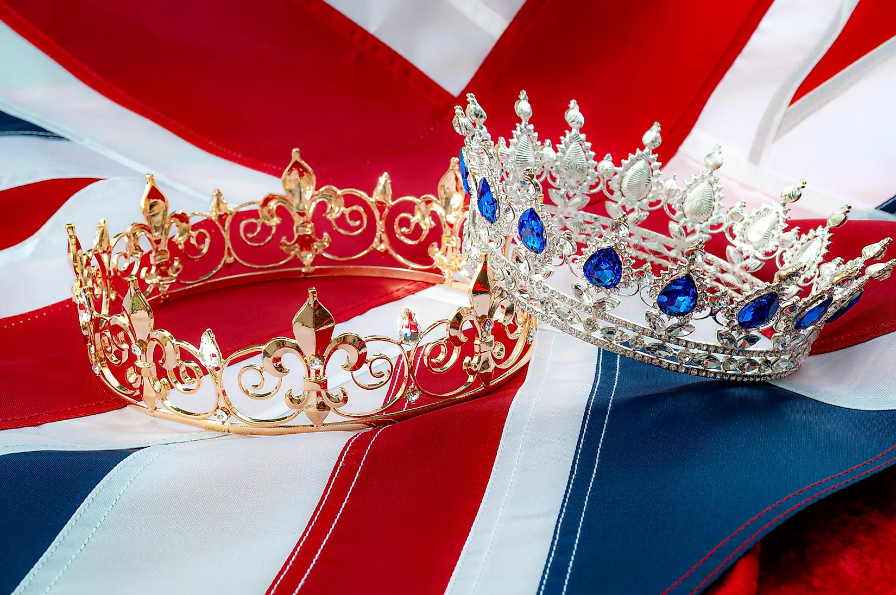
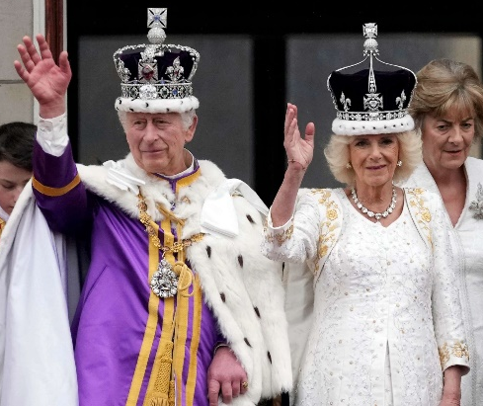
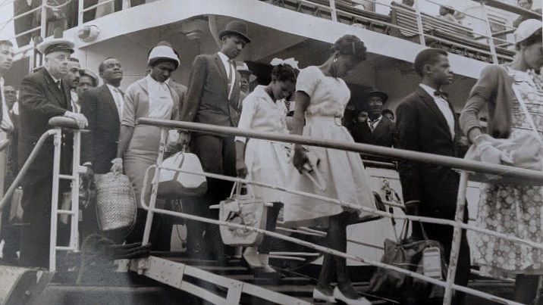
Bridgemere CE Primary School Year Group: Y1/2 Term: Summer
English
‘2 Queens and a King’ Elizabeth I, Victoria & King Charles III
---------------
‘Coming to England’
This term, we will begin by looking at and comparing the monarchy over time. During the second half of the term, we will look at The Windrush Generation and the cultural changes associated with this.
Maths
In English, we will be using the texts ‘The King who Banned the Dark’ and ‘Jack and the Baked Beanstalk’ to help us to plan, write and edit our own banning narrative and twisted tales. Also, across the Summer term we will be investigating the art of persuasion!
Year 1 will be learning about:
fractions, numbers to 100, recognizing money as well as beginning to tell the time.
Year 2 will a be learning about:
shape and space, time and fractions
Music
In Music we will be looking at ‘Changes’ we will learn spring-themed songs and compose a piece of springtime music
During the second half term, we will look at ‘Whatever the weather’. We will sing songs about the weather, in unison and as a round.
Art
In Art, we will be learning what expressive painting is. We will look at brushwork and how other artists use mark-making and colour in their work.
History
Design and Technology
This term is all about History! We will be looking at timelines and noticing the change of significant kings and Queens. We will compare similarities and differences between monarchs. During Summer 2, we will study the Windrush Generation, why some people left their country and what effect it had on them, their families and Britain.
In Design and Technology, we will be preparing fruit and vegetables to create a tasty snack. We will use our senses to taste a variety of foods and will focus on key preparation skills.
R.E/Spiritual and Moral
Science
P.E
Computing
In R.E. we will be focusing on Holy Books. We will be looking at World Faiths and focusing on holy books associated with each faith. We will study The Bible as the Christian holy book and look more closely about how it is a library of books telling God’s Big Story.
In Summer 1, we will be learning about seasonal changes and looking at questions such as; Why does our weather change? How can weather affect us? In Summer 2 we will study plants and trees asking; How do plants spread their seeds? What are the parts of a plant? What plants can I find in my garden?
In PE, we will begin the summer term by working on our fundamental skills for hitting, catching and running before moving onto lots of athletic skills ready for our sports day.
In Computing, we will look at and use spreadsheets. We will present data in the form of pictograms and we will be creating presentations and sharing them with our friends in the class.

