Slide 1

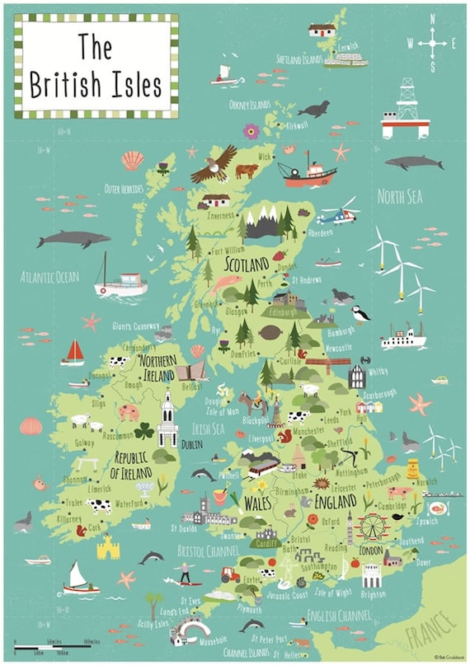
Bridgemere CE Primary School Year Group: Y1/2 Term: Spring
English
‘Is the United Kingdom the same all over?’
This term, the children will be looking the countries and their capital cities that make up the United Kingdom as well as the seas surrounding the amazing British Isles.
Maths
In English, we will be using the texts ‘The Secret of Black Rock’ and ‘The Night Gardener’ to help us to plan, write and edit our own return and setting narrative. We will also be looking at how we write a diary entry.
Year 1 will be learning about:
Numbers to 50 before naming and identifying 2d and 3d shapes.
Year 2 will a be looking at division specifically dividing by 2, 5 and 10 before moving on to measurement of length, weight and temperature.
Music
Art
In Music we will create new lyrics to fit a known melody and rhythm. They will accompany their singing with percussion instruments and compose a piece of music describing the sea.
In Art, we will be Exploring architecture and creating architectural models through the understanding the work of Hundertwasser
Geography
Design and Technology
This term is all about geography! We will be looking the countries and their capital cities that make up the United Kingdom as well as the seas. The children be use a map to identify the 4countries on a map before they look at similarities and differences in their landscapes.
In design and technology, we will be exploring and evaluating free structures. The children will examine frame and shell structures before creating their own.
R.E/Spiritual and Moral
Science
P.E
Computing
In R.E we will be focusing on our favourite things God has created providing an opportunity for reflection on feelings of awe, wonder, delight and mystery in relation to the natural world. After half term the children will explore the Easter Story and it’s symbols.
In science, we will be learning about people and their pets and how we look after different animals before looking closely habitats and food chains. We may even try growing some of own foods!
In PE, we will begin the spring term by working with a dance specialist and completing our next unit of gymnastics before working on key fundamental skills in a range of games scenarios.
In Computing, we will be continuing to learn about how to keep safe when online and how email can be used as a form of communication before we compose simple algorithms.

