Slide 1
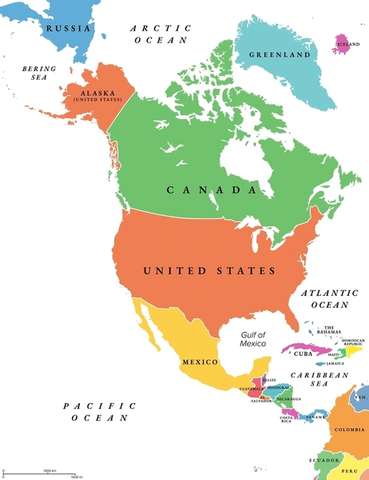
Bridgemere CE Primary School Year Group: Y5/6 Term: Spring Term
Geography: North and Central America
English
Maths
The Book of Lost Adventure by Teddy Keen
The Ways of the Wolf by Smriti Prasadam.
Our class novel will be The Inheritance Games by Jennifer Lynn Barnes.
Fractions, decimals and percentages
Graphs
Position and movement
Area and perimeter
R.E/ Spiritual and Moral
Science
In RE we will be looking at why is the Exodus such a significant event in Jewish and Christian history? And Why do Christians celebrate the Eucharist? As well as exploring multi-faiths such as Judaism, Sikhism, Islam and Hinduism.
Animals including humans as part of this topic we will be exploring the human life cycle from foetus to adulthood, ‘Light’ in Spring 2 during this time we will be investigating how light travels and experimenting how we can make light bend and curve.
MFL
Geography
In MFL we will be looking at using common phrases and questions, building up to being able to talk about going on holiday.
This half term we have a geography focus, we are looking at Northern and Central America. We will be investigating human and physical features of each of these countries as well as being able to name and locate the capital cities and be able to distinguish the difference between a country and a state.
Art/DT
Music
P.E
Computing
Activism - Explore how artists use their skills to speak on behalf of communities.
Textiles - Combining different fabric shapes
In Music we will be looking at ‘The Samba’ and ‘Music from Around the World’.
Dance, gymnastics, netball and basketball
Blogging, spreadsheets and understanding binary

