Slide 1
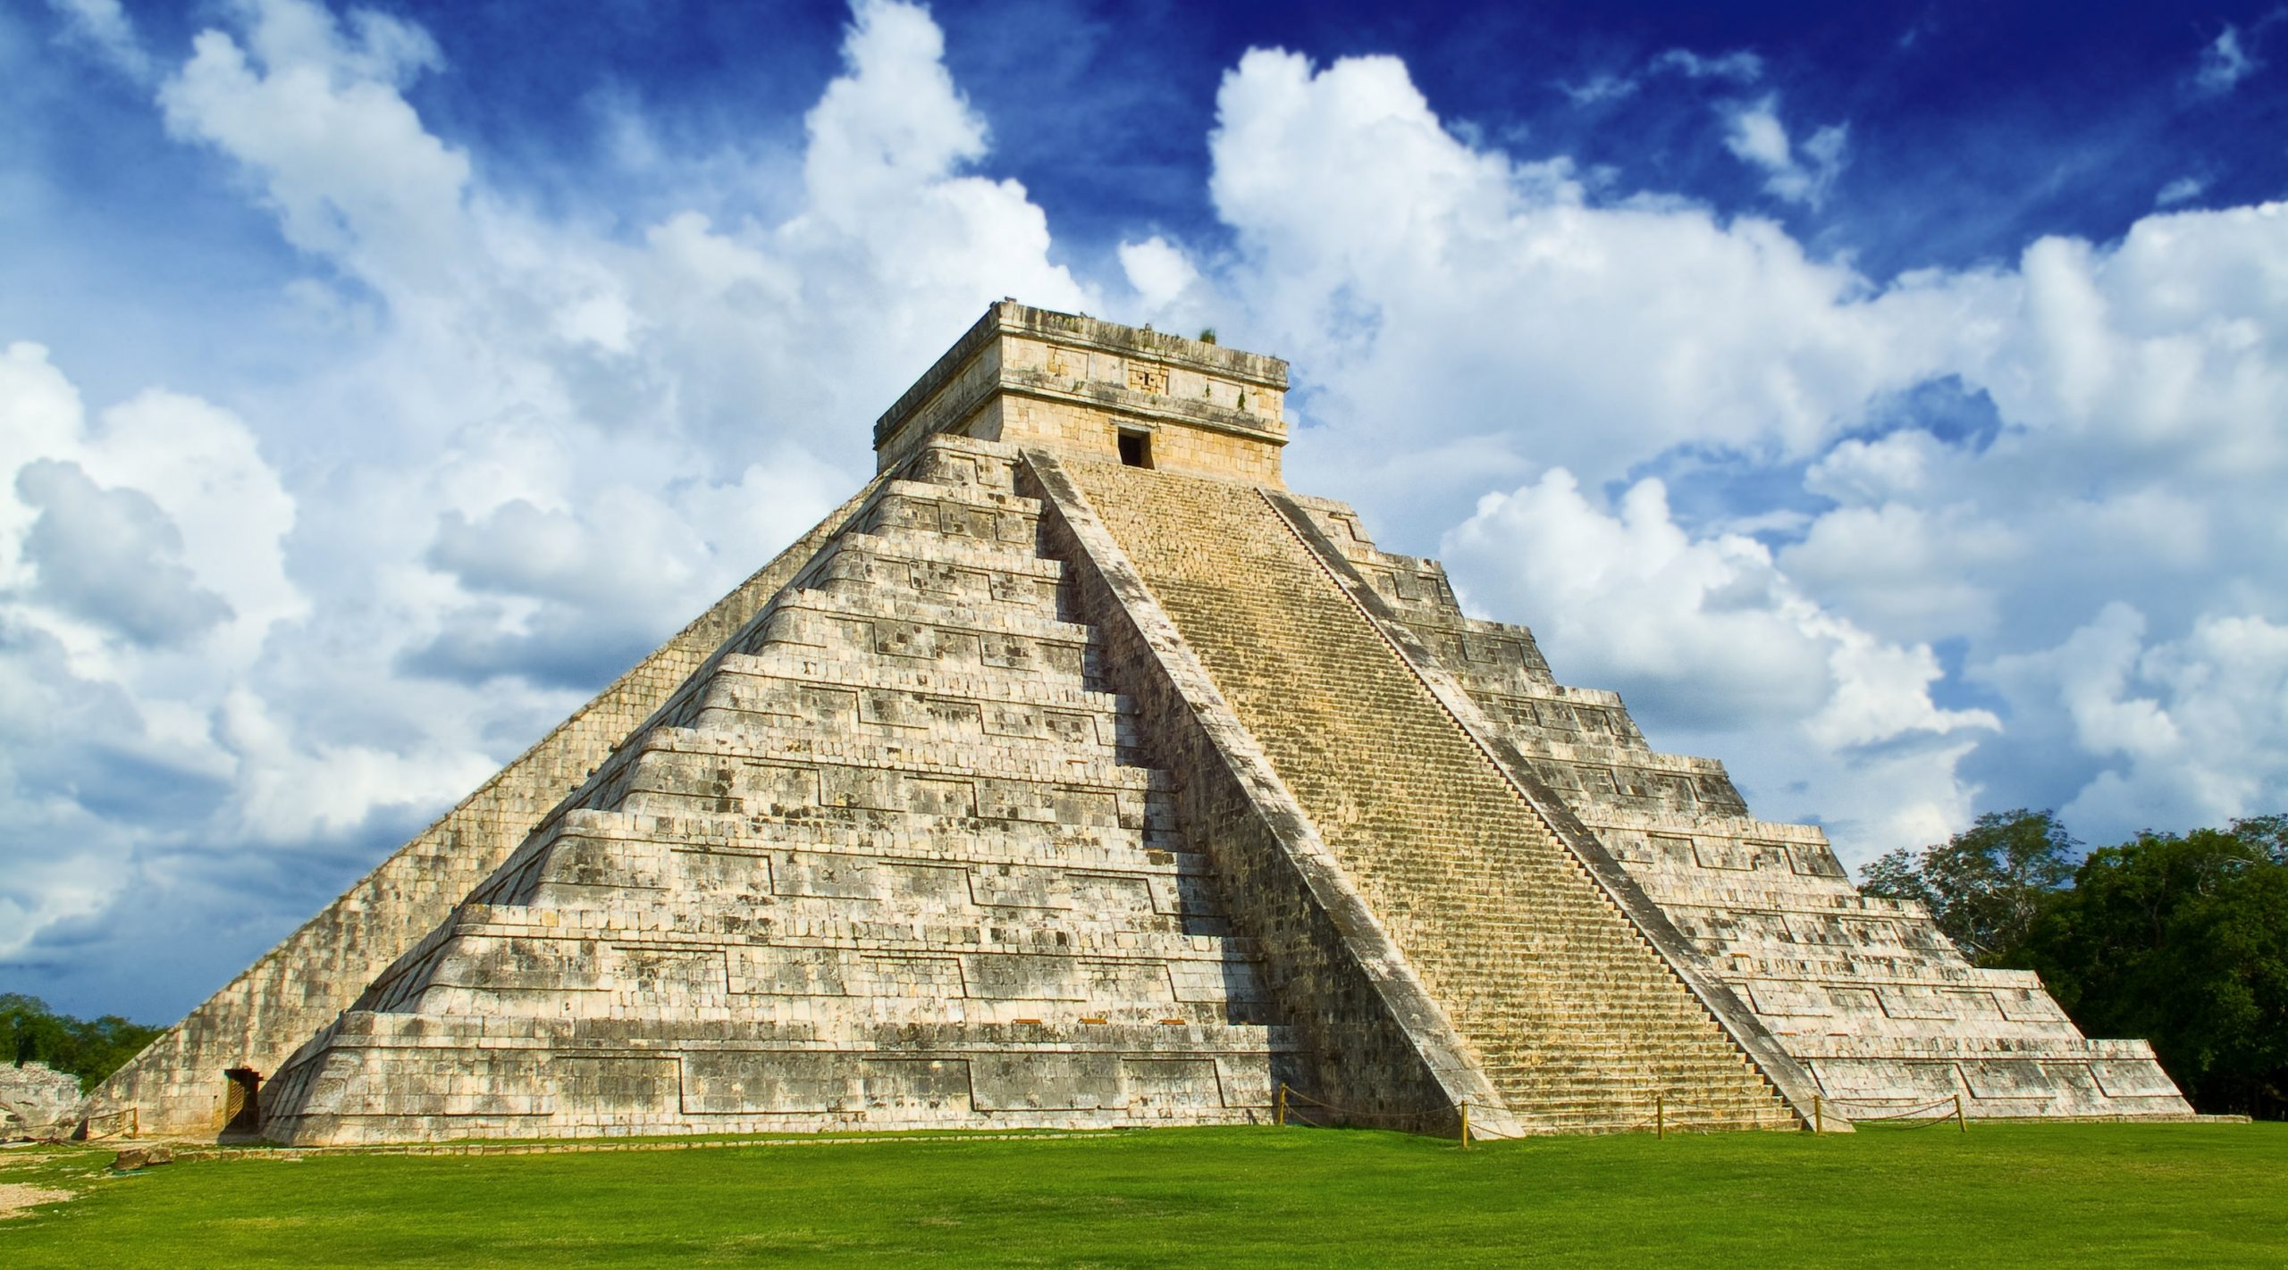
Bridgemere CE Primary School Year Group: Y5/6 Term: Spring Term
History and Geography: The Mayan Civilisation and South America.
English
Maths
When We Walked on the Moon by David Long.
Exploration narrative and a mission log
Shackleton’s Journey by William Gill
Endurance narrative and a magazine article
Fractions, decimals and percentages
Graphs
Position and movement
Area and perimeter
Art/D&T
Science
We will be exploring food and culture and seasonality and mixed media of land and city landscapes.
In Science, we will be looking at forces. We will be imagining we are theme park designers.
Geography/History
MFL
We will be looking at the civilisation of the Mayans and discussing and debating as to whether they were more or less advanced than Britain in 900AD. We will be comparing and contrasting this civilisation with other eras that we have already looked at such as the stone age, Roman Britain and the Middle Ages.
In geography we will be looking at South America, we will delve into the various regions discovering at the differences and comparing these to other places that we have previously looked at.
In MFL we will be looking at using common phrases and questions, building up to being able to talk about going on holiday.
R.E/Spiritual and Moral
Computing
Our R.E topic this term is looking at Christian Community and Resurrection
Music
P.E
In Computing, we will be learning about quizzing using Purplemash. We will also be looking at e-safety through PSHE.
In PE, we will take part in
Dance and Gymnastics
In Music we will be looking at ‘Performance Poetry’.

