Slide 1
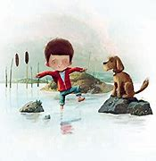
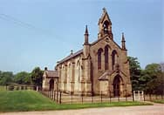
.
Bridgemere CE Primary Curriculum Year Group: Class One Term : Spring 1
Expressive Arts and Design
A Passport to Bridgemere:
Exploring our local area
Maths
I can draw with increasing complexity and detail
Sketching local attractions
Art – Primal painting
I can explore different materials
Using junk modelling
White Rose Maths
I can represent, compare 0-5
I know the composition of 0-5
I understand one more one less
I can compare mass
I can find a balance
I can explore capacity
I can represent and compare 6,7 and 8
I know the composition of 6,7 and 8
I can understand time
Physical Development
I can use one handed tools and equipment
I can form my letters correctly
I can combine movements
PE - Dance
Movement to music
Personal, Social and Emotional
Understanding the World
I can recognise how I am feeling
I can think about others
I can adapt my behaviours
I understand changing seasons
Autumn-winter- spring- summer
I understand the process of changing states
Melting and Freezing
I understand differences
between materials
I can discuss how I celebrate different events.
World Book Day
Lunar New Year
Shrove Tuesday
I can keep living things safe
Big School Birdwatch
Planting seeds
Literacy
Ready Steady Write: The River by Tom Percival
I can order a simple story
I can write a story map
I can write some letter correctly
A Story from a storyboard
Writing a story map
Read Write Inc: Review of Set 1 sounds, ‘special friends’ additional digraphs & ‘red/tricky words’
I know some of my letter sounds
I can use my letter sounds to write
Communication and Language
RE
Christian community
Visiting St. Johns Church
Retelling the story
Alliteration
I can talk about my experiences
I can share milestone events
I can describe a route

